Slide 1
2013 DCCC Finance Training
Welcome

Slide 2
Introductions
2013 Organizational Chart
2013 Contact List
Finance Dept. Responsibilities
Notes:
In binder: Agenda, Org Chart, Contact List, Dept Responsibilities

Slide 3
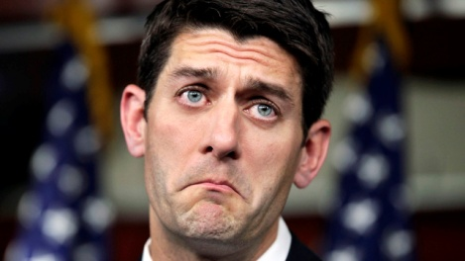
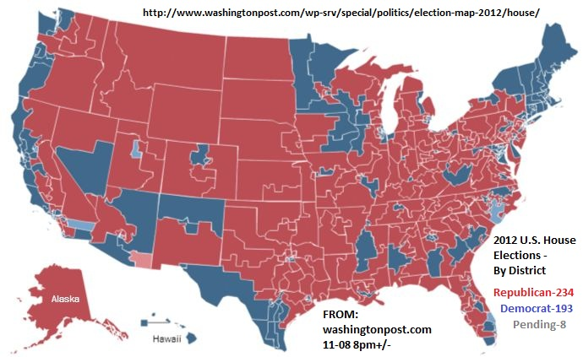
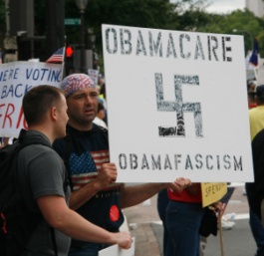
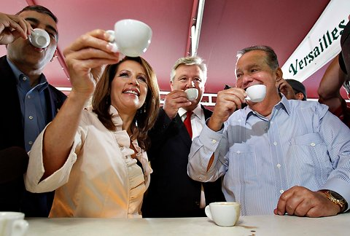
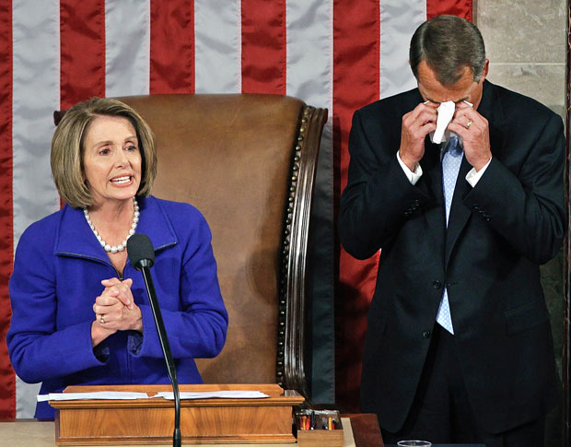

Why are you here?

Slide 4
Why are you here today?
To learn how we do things here at the Committee
To learn how the day-to-day operations work
To gain knowledge about national party rules and regulations
To make this all make sense
To learn how to do stuff you didn’t event know you had to do

Slide 5
Finance Department Responsibilities
Missy Kurek –Deputy Executive Director for Finance
Main point of Contact in Leader Pelosi’s office
Work with Leader’s office and Chairman’s office to create finance plan based on events
Staff the Leader and the Chairman during DCCC events in DC and in other cities around the country and during call time
Approves all National events and meeting materials before they are sent to a member of the caucus
Manage and track all money flow into Committee
Oversee and manage the entire finance team

Slide 6
Finance Department Responsibilities
Stella Ross–National Finance Director
Work with the Leadership and the caucus to coordinate their dues for the DCCC
Main point of Contact in Chairman’s Office surrounding all DC activities
Work with press and political on member activity for the DCCC
Staff the Leader and the Chairman during DCCC events in DC and in other cities around the country and during call time
Manage the caucus report
Coordinate member dinners
Approves all DC events and meeting materials before they are sent to a member of the caucus
Manage and track all money flow into Committee
Oversee and manages the entire finance team
Lead on overall donor maintenance – this includes all correspondence, events, issues conference etc…

Slide 7
Finance Department Responsibilities
Kellie Dunn– Finance Operations Director
Scheduling and Briefings
Moving Schedule Requests through the approval process
Updating Leader’s Long Term Schedule
Establishing due dates for NP, SJI, and Other Member materials, and collecting all materials to send up to NP’s office or SJI’s office (Brenna)
Keeping and Distributing Master Finance Calendar of Events
Tracking invitations and moving through Invite Approval Process
Tracking all host vets
Money
Logging and handling all Finance contributions
Tracking Finance Money In, Hard Commits, and Problem Checks
Checking and pulling Online money
Liaising between Finance and CFO
Send Daily SNAP of money in to DCCC Exec. Leadership
Tracking all contributor vets
Bundling
Tracking all things related to Bundling, including Agent Letters
Sending Final bundling report to Compliance
NGP
Running weekly clean up reports and periodic spot checks in NGP
Coordinating with Dan for Finance specific NGP needs
Creating Source Codes for Events
Consultants
Processing all Consultant Invoices and Reimbursements
Joint Victory Funds
Coordinating with Jackie, Accounting, and Finance on status of committee and needs
Other Items, as needed

Slide 8
Finance Department Responsibilities
Krista Jenusaitis – Director of Events
Plan and execute all Finance and DCCC events…pick venue, caterers, rentals, flowers, negotiate contracts, arrange for payments, contract all vendors and photographers
Assist Candidate Fundraising with events
Work with event hosts on Home Hospitality, In Kind, and payments
Create invites and mailings; order invite and stationary supplies
Maintain all talent connections and make all talent asks for the DCCC.
Production Manager for larger concert events
Lead in advancing and executing all logistics for the Napa Valley Retreat which include hotel blocks, bus reservations, gift bags, all meals, and an Issues Conference, as well as leading the trip
Create and control the Finance Department’s events budget that includes projected goals and costs, as well as actual money raised and spent for each event organized by quarter
Help the Finance Directors determine if an event is financially feasible and brainstorm ideas for future events
Work on all logistics that are involved with 2012 Convention; hotel blocks, site selections, all event logistics, transportation coordination, Pelosi schedule, etc
Work on all event logistics with White House surrogates

Slide 9
Finance Department Responsibilities
Courtney Lee-Ashley– Deputy National Finance Director
Work with the Leadership and the caucus to coordinate their dues for the DCCC
Work with press and political on member activity for the DCCC
Manage the caucus report
Coordinate member dinners
Manage our entire DC/PAC Finance Team

Slide 10
Finance Department Responsibilities
Johana Borjas– National Finance Assistant
Responsible for Missy and Stella’s schedules
Collect and return all items needing approval from Stella & Missy
This includes: leave requests, check requests, travel expenses, call sheets, briefings, cards, talking points, etc.
Compile travel binder for Missy and Stella when staffing NP or SJI
Compile weekly reports for SJI
Assist regionals with fundraising events, outreach and other tasks as needed
Assist with National events (Napa, Conference Calls, NY Issues Conference)

Slide 11
Finance Department Responsibilities
Regional Finance Directors
Responsible for making sure region achieves monthly goals
Primary staff for finance events
Develop and maintain donor relationships
Manage the staff (deputies and finance assistants) in their department
Deputy Directors
Support Regional Director with events, donor targeting and daily tasks.
Lead point of contact for smaller events throughout the region
Finance Assistants
Process checks and makes sure all Money In is up to date
Assists in event staffing- prepping nametags, briefings, cards, etc.
Assists in preparing call sheets
Works closely with regional director & deputy directors to develop and implement strategies to achieve monthly goals through events and other avenues of solicitation.

Slide 12
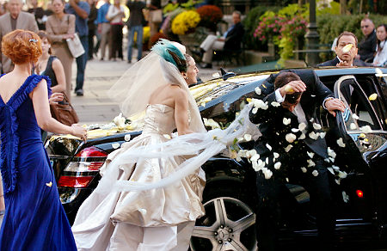

How do we do it?
We Schedule Events
Events make us Money
Money makes us fund races
Races make us take back the majority so we don’t have to go through this again:

Slide 13
Part 1:Scheduling an Event
Remember: Leader Pelosi and Chairman Israel are our biggest fundraisers, and it is our job to keep them and their staffs happy. What comes next is how we do this.

Slide 14
Leader Pelosi Scheduling
Regional's work with Missy and Stella to plan national events around the country
Once you have the go ahead for an event (date that works for your hosts), you will do a Schedule Request:

Slide 15
Leader Pelosi Scheduling: Schedule Request Procedure
Do a Schedule Request (see example)
Give to Johana who will give to Stella then Missy approval
Johana will give you back w/ any edits
Once you make edits and it is approved, email final version to Kellie, with date (if different) and she will send up to NP’s office

Slide 16
Leader Pelosi Scheduling: NP’s Long Term Schedule
What is the “Long Term”?
An enormous pdf document that captures Leader Pelosi’s entire schedule for that calendar year
This document lives in the top tier in Kellie’s inbox. You can take it to your desk, but consider it like a Library book was back when we had libraries. You need to tell Kellie if you are taking it, and you need to return it once you are done. It cannot float around the office.
This is our most important tool for NP fundraising, and you need to utilize it
An updated one will be available every day

Slide 17
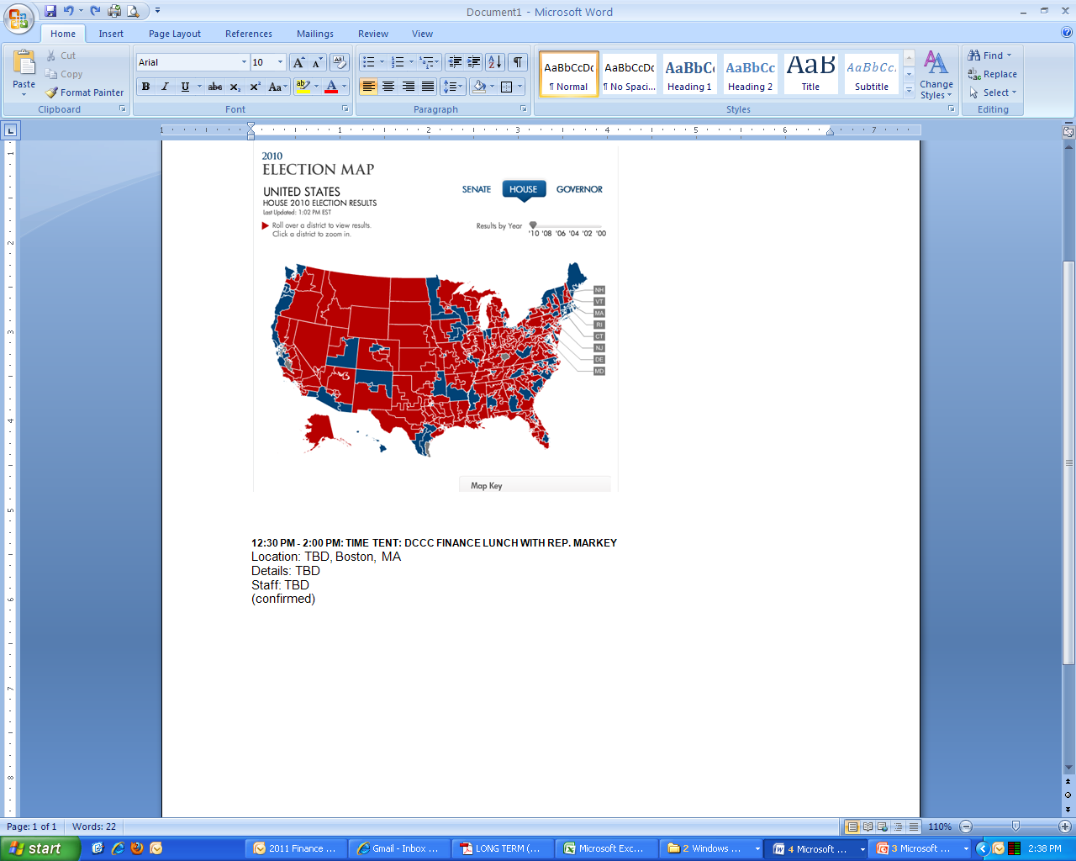
Leader Pelosi Scheduling: NP’s Long Term Schedule
Once your event has been added to the LT, it is YOUR responsibility to update it.
Generally a shell of the event will be added that looks like this:

Slide 18
Leader Pelosi Scheduling: NP’s Long Term Schedule
Your job is to fill in the holes as you have the information.
Every event needs the following details
Location (Name of location, Room, Floor, Suite #, exact address and zip code)
Details:
-Attendees (Total # and VIPS (Members) confirmed to attend)
Reservation information (# and name it is under)
Event run time (for events, not meetings)
Timeline that is exactly what you put in your briefing)
Staff (Missy, Stella, etc, with cell phone number)
Contact (this is the SITE contact. This is the person the security detail will call to do the walk-thru of the event. This is important.

Slide 19
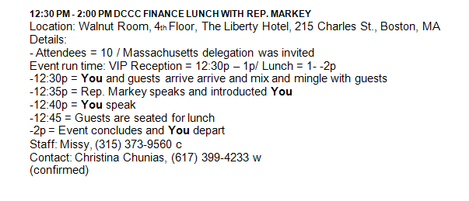
Leader Pelosi Scheduling: NP’s Long Term Schedule
So what was this:
Now becomes this:

Slide 20
Leader Pelosi Scheduling: NP’s Long Term Schedule
To send a Long Term Update:
Email Kellie and cc Missy and Stella, and your entire team
Subject: Long Term Update
This is important. It should say nothing more and nothing less than this.
Body: Relevant info only. I need to be able to read this quickly and pick out only what I need to send up

Slide 21
Chairman Israel Scheduling
We will likely receive notice about SJI travel in two ways:
Missy and Stella will find out about travel through senior staff, or meetings with SJI, or travel that he will be doing with NP
Missy and Stella will work with Brenna to secure travel dates that may be available for Finance
Once a date with the Chairman is secured, Brenna will talk with Missy and Stella to determine what region SJI should travel to based on your needs:
In order to make decisions on his travel appropriately please send Brenna regular requests on where you would like him to travel to in your region and what events/meetings you are proposing. The more specific you can be about where and how you think he can be useful the easier it will be to set his travel.
Regional Responsibilities:
After the region is selected Brenna will work with the regional directors to draft SJI’s schedule.
At this point the regional directors will then be responsible for sending confirmation updates to Brenna and Kellie. Kellie will need to know what is confirmed and should be added to the various calendars. For example:
SJI is traveling to the South. Brenna will work with Amelie to draft a tentative schedule that will get approved by Brenna. Once this schedule is set, Amelie is responsible for emailing Brenna and Kellie as the actual meetings are confirmed
If a regional would like to alter the approved schedule, i.e. change meeting times, event times, or types of meetings they should ask Brenna
In most instances, like NP, SJI travel will occur within one region on a given trip, meaning the region in question will be responsible for all travel material.
SJI briefings should be given to Stella and then Missy for approval.
When briefings are complete they should be sent to Brenna and ‘cc Kellie.

Slide 22
Other Member Scheduling
When Members other than NP or SJI have agreed to host an event or meeting, you should always do the following:
Get approval from Stella and Missy
Send a Calendar Update for Kellie so she can add to the master Finance Calendar
Prepare briefings and send talking points requests as needed
Send the invitation through the normal procedures

Slide 23
Invitations
Not as easy as you would think

Slide 24
Invite Approval Process: NP Events
Send Host Vets for potential or confirmed hosts
Regionals get approval from Missy and Stella as to hosts and MOCs whose names will be listed on the invite
Regionals design the first iteration of the invite and when complete, regional gives to Johana
Johana gives to Missy and Stella for sign off
Regionals make changes (if need be), and email final approved version to Hayley Dierker, and CC Kellie, your regional team and Jesse Ferguson, for legal approval
Please make the subject, “For Legal Approval: January 30th Midnight Snack” or something referencing the event
Hayley will either respond that the invite is good to go, or give you changes. Once an invite has been approved by legal, send it to Kellie and she will send to NP’s office for final sign off
Once Kellie hears back from NP”s office, she will let you know that the invite is good to send out
Prior to sending out, Regionals send to all hosts and MOCs who have agreed to lend their name to invite. All hosts and Members on the invite MUST approve their own name. (You don’t have to cc Kellie on this part)

Slide 25
Invite Approval Process: SJI Events
Sent Host Vets for potential or confirmed hosts
Regionals get approval from Missy and Lindsey as to hosts and MOCs whose names will be listed on the invite
Regionals design the first iteration of the invite and when complete, regional gives to Johana
Johana gives to Missy and Stella for sign off
Regionals make changes (if need be), and email final approved version to Hayley, and CC Kellie, your regional team and Jesse Ferguson, for legal approval
Please make the subject, “For Legal Approval: January 30th Midnight Snack” or something referencing the event
Hayley will either respond that the invite is good to go, or give you changes. Once you have either made the changes or gotten sign off, email it to Kellie, who will send to Brenna for approval
Please make the subject, “For SJI Approval: January 30th Midnight Snack” or something referencing the event
Once an invite has been approved by SJI’s office, you are good to send out once all other MOCs and/or hosts have approved their names
Prior to sending out, Regionals send to all hosts and MOCs who have agreed to lend their name to invite. All hosts and Members on the invite MUST approve their own name. (You don’t have to cc Kellie on this part)

Slide 26
Invite Approval Process: Other Member Events
Regional's get approval from Missy and Stella as to hosts and MOCs whose names will be listed on the invite
Regionals design the first iteration of the invite and when complete, regional gives to Johana
Kellie gives to Missy and Lindsey for sign off
Regional's make changes (if need be), and email final approved version to Kristie and Beth, and CC Katherine, for legal approval
Please make the subject, “For Legal Approval: January 30th Midnight Snack” or something referencing the event
Kristie or Beth will either respond that the invite is good to go, or give you changes. Once you have either made the changes or gotten sign off from them, you are good to send out once all other MOCs and/or hosts have approved their names
Prior to sending out, Regionals send to all hosts and MOCs who have agreed to lend their name to invite. All hosts and Members on the invite MUST approve their own name. (You don’t have to cc Katherine on this part)

Slide 27
Invite Approval Process
*Note: as always, remember that each of your hosts should pass vetting and have a record set up in NGP before going on an invite draft. I recommend you send your hosts vets up ASAP, even if they are not confirmed to host yet. You don’t want a pending host vet to hold up your invite!!!!!

Slide 28
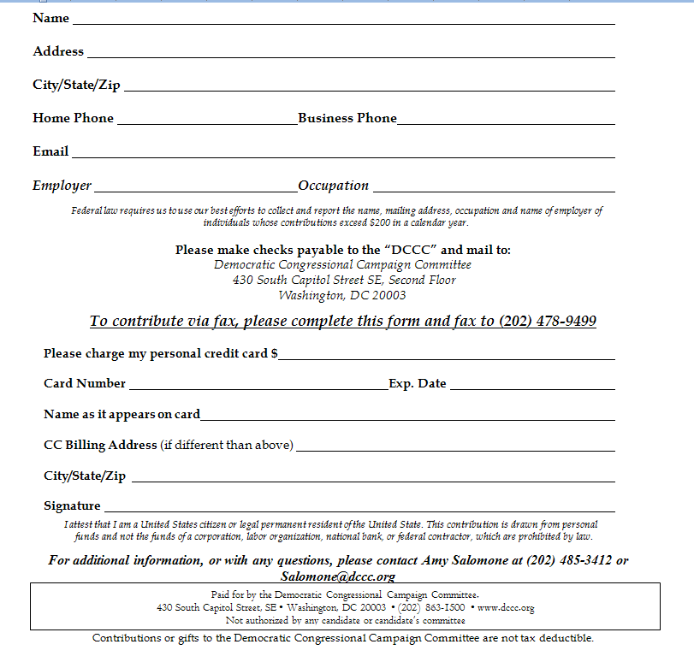
Invite Reply Template
While many invites are created using previous invites as a template, the reply MUST contain the information in the format seen here.
REMEMBER: Do not use old replies! Nothing makes Jackie more angry! (well, that’s not true, but you get it)

Slide 29
Event Source Codes
Every event that will either raise money or incur expenses must have a source code in NGP
Kellie makes the source codes, and in order to get one, you must send her an email that says:
Source Code Request: January 30th Finance Training
Always Include:
Whether or not this is a new event or has happened in previous years
The date, location, and host of event

Slide 30
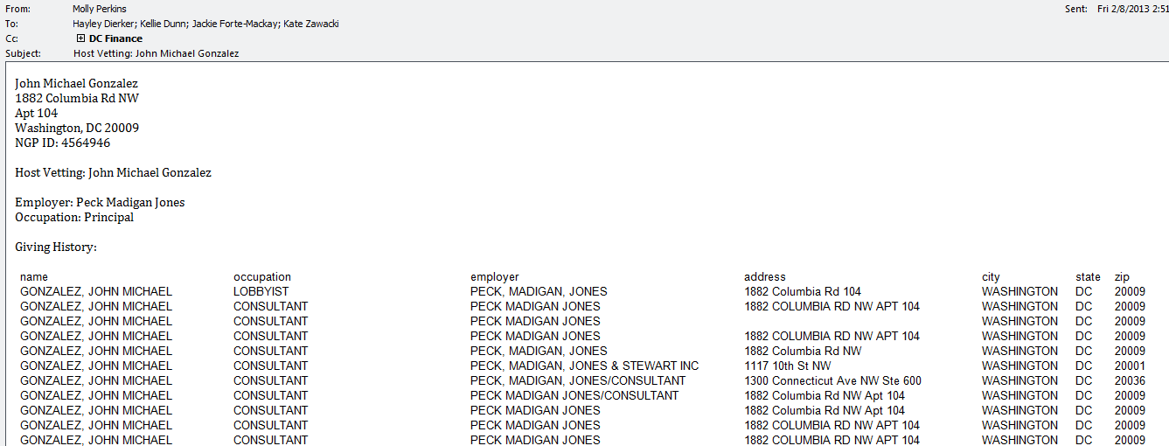
HOST VETS: How to send
Note: Every host must have an entry in NGP so Kellie can update his or her vetting status
*Host Vets trump Contribution vets
If a donor has a valid host vet, they do not have to be re-vetted for a contribution, but not vise versa

Slide 31
Setting up an Event Webpage
Send Kellie,‘cc region, an email with the subject “Event Web Page Request: May 11th Washington DC DCCC Afternoon Snack hosted by Katherine O'Koniewski”
Include in the email the following info:
Header:
URL (dccc.org/xxxx):
Description Text:
Contribution Amounts and Levels: (Note- Kellie should always be one of the contribution alrets)
Needed by:
Contact Info:
E-mail address for Contribution Notifications:
Kellie will send this request to Raffi and Greg directly, and cc your region.
Raffi and Greg will reply when it is up
If you have any changes, you can reply directly to Raffi/Greg’s email

Slide 32
Setting up an Event Webpage
Subject: Event Web Page Request: February 26th Chevy Chase, MD DCCC Reception hosted by Nancy and Harold Zirkin
Header: DCCC Reception Hosted by Nancy and Harold Zirkin, featuring Leader Nancy Pelosi and DCCC Chairman Steve Israel
URL: dccc.org/chevychase
Description Text: Please join Nancy and Harold Zirkin for a special event with Democratic Leader Nancy Pelosi, DCCC Chairman Steve Israel, the Honorable Sander Levin and the Honorable Chris Van Hollen on Tuesday, February 26th, 2013 at 7:30pm.
Location: The home of Nancy and Harold Zirkin
Chevy Chase, Maryland
(Address provided upon RSVP)
Contribution Amounts and Levels:
Speaker’s Cabinet: $30,800 per couple
Guest: $10,000 per person
Friend: $5,000 per person
Needed by: Tuesday, January 22, 2013
Contact info: To RSVP or for additional information, please contact Becca Durr at (202) 485-3445 or durr@dccc.org.
Contribution Alerts: Becca Durr durr@dccc.org Kellie Dunn dunn@dccc.org

Slide 33
Setting up an Event Webpage
Event site requests MUST go through Kellie and Kellie only. Please do not email the digital team unless it’s a quick edit.
Raffi Appel (appel@dccc.org) does all event requests/edits.
Please proofread all requests before sending. It will only save yourself time in the future.
Please check that you have added per person/per couple to each ticket level before sending.
All event requests need to be sent 48 hours in advance. We’ll do our best to get these up ASAP.

Slide 34
Talking Points Requests
Leader Pelosi and Chairman Israel will need talking points or remarks for every DCCC event, unless it is a meeting
Talking points requests must be sent to Katie Mulhall AS SOON AS POSSIBLE
You should always find out if other MOCs will want talking points as well. *DO NOT assume they do or do not
Once you have filled out the following form, email it to Katie, and cc Kellie and your team

Slide 35
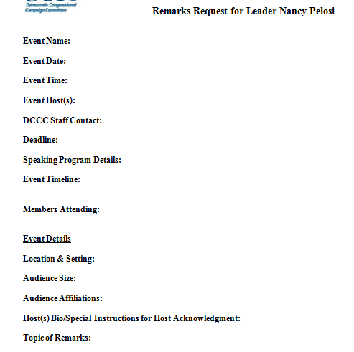
Talking Points Request Format

Slide 36
Events
Let’s Hear it for Krista

Slide 37
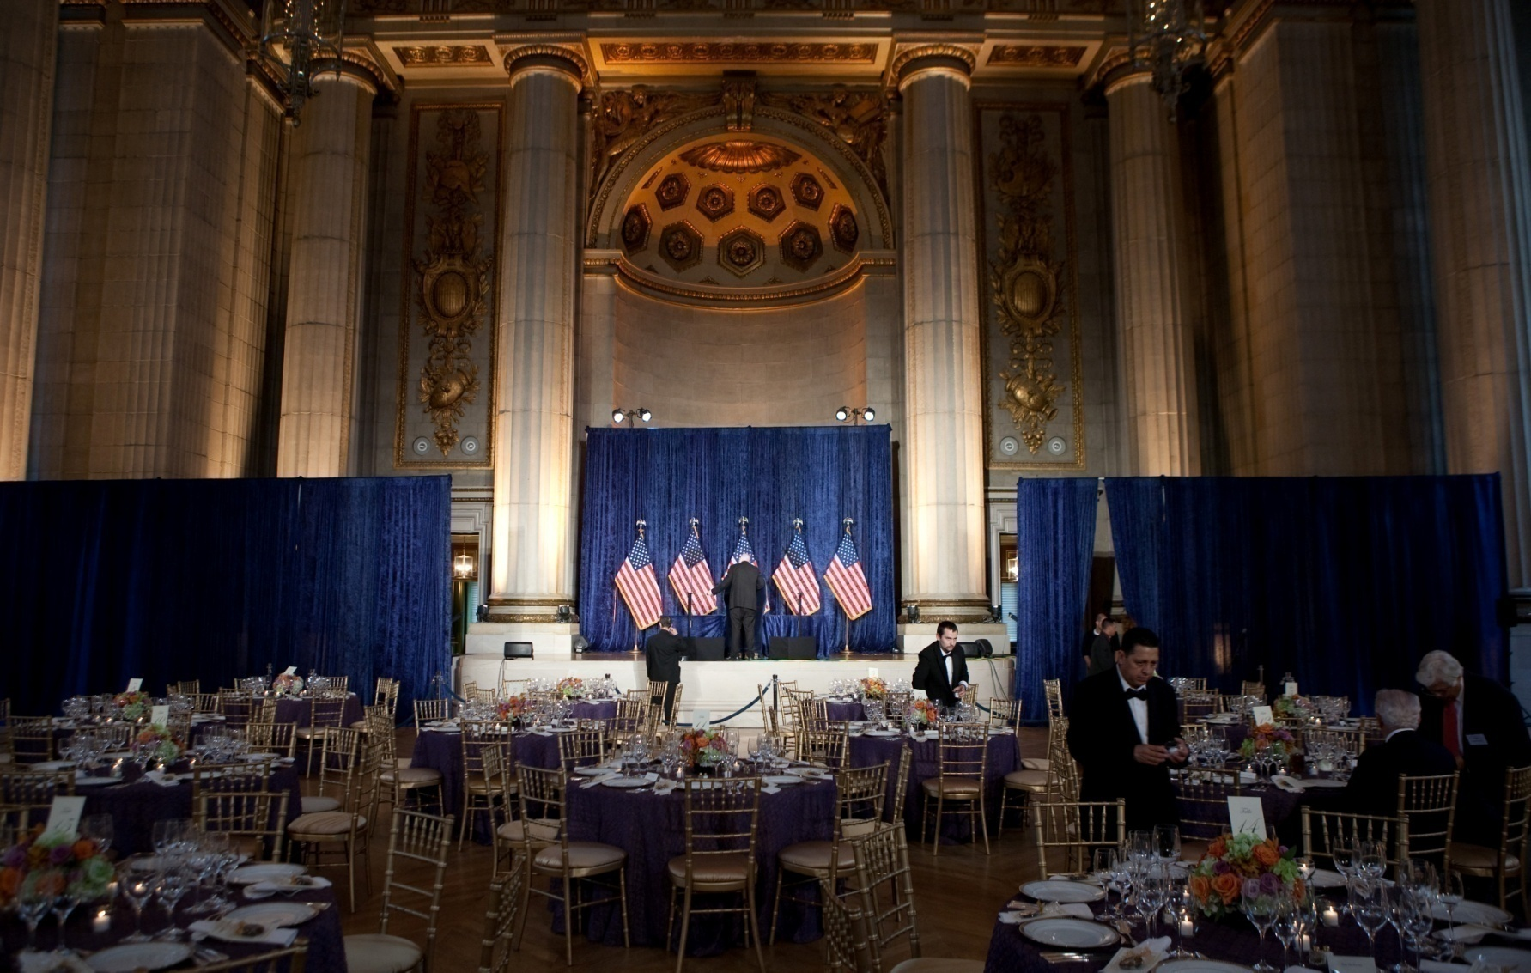
The World Of DCCC EVENTS!

Slide 38
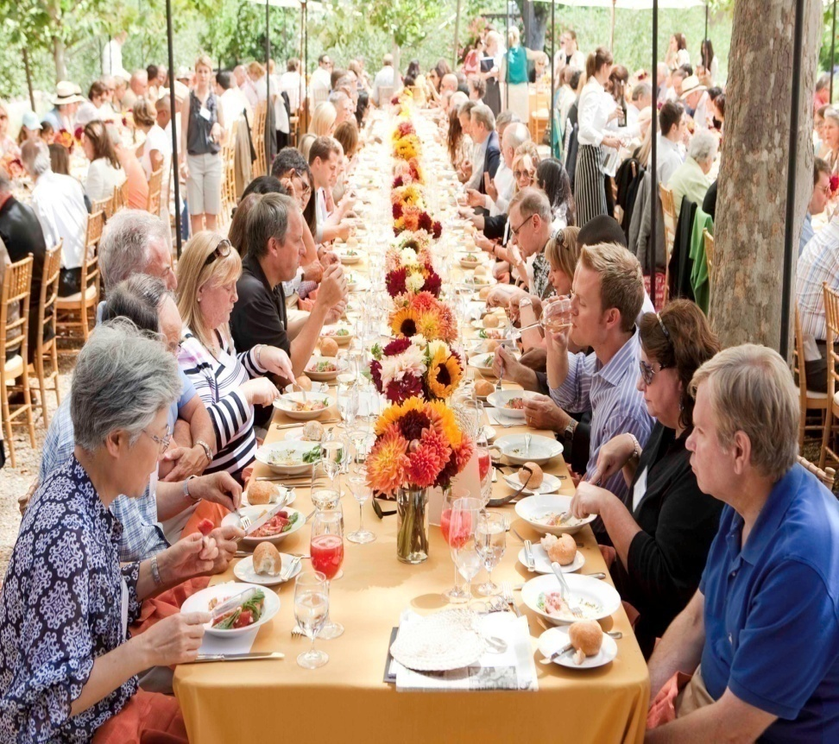
I have a confirmed event… What do I do now?
Is this an annual event? Has this occurred before?
If you do not know I likely have in my files or it is saved in the finance drive
What is the fundraising goal attached to the event?
All DCCC events need to stay at 4% of the overall fundraising goal
Ex: If you are hosting a dinner and the goal is $100,000 the TOTAL event costs need to come in at $4,000 or less
~ This includes ALL costs (food, beverages, rentals, flowers, etc )
~ This does NOT include staff travel expenses but PLEASE be mindful of booking your travel as economically as possible as it is all linked to the overall event costs in the end
~ There are certain exceptions to the rule that Krista can talk to you about on an individual basis when these occur

Slide 39
I have a confirmed event… What do I do now continued
Contact Info for the Hosts
Once you have an event confirmed it is the responsibility of the Regional Director to tell the host that Krista will be reaching out to them
What is the best method for Krista to reach out to the hosts (phone/ email)
Host DCCC donations
Has the host of the event written to the DCCC this year or are you planning on having them write for this event?
If the host wants to In Kind the event – are you ok with that?

Slide 40
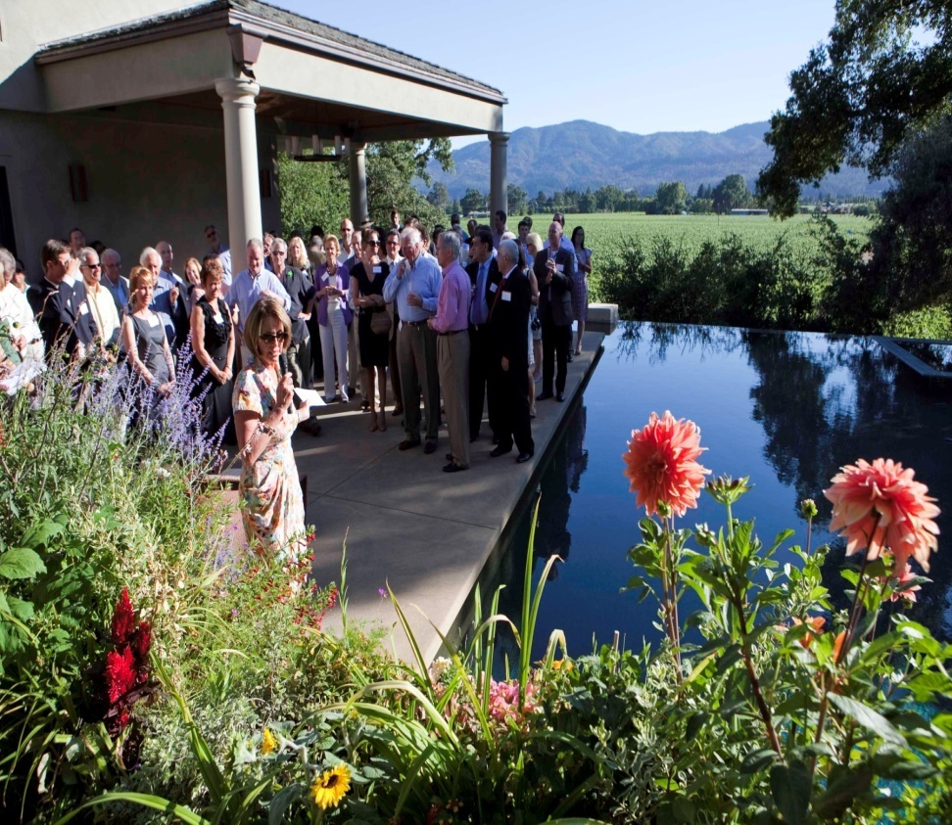
Event Planning
To talk to the host about all event related logistics including
Menu
Flowers
Layout
AV
Payment options
photographer
Security/ Walk throughs
Krista’s Responsibilities

Slide 41
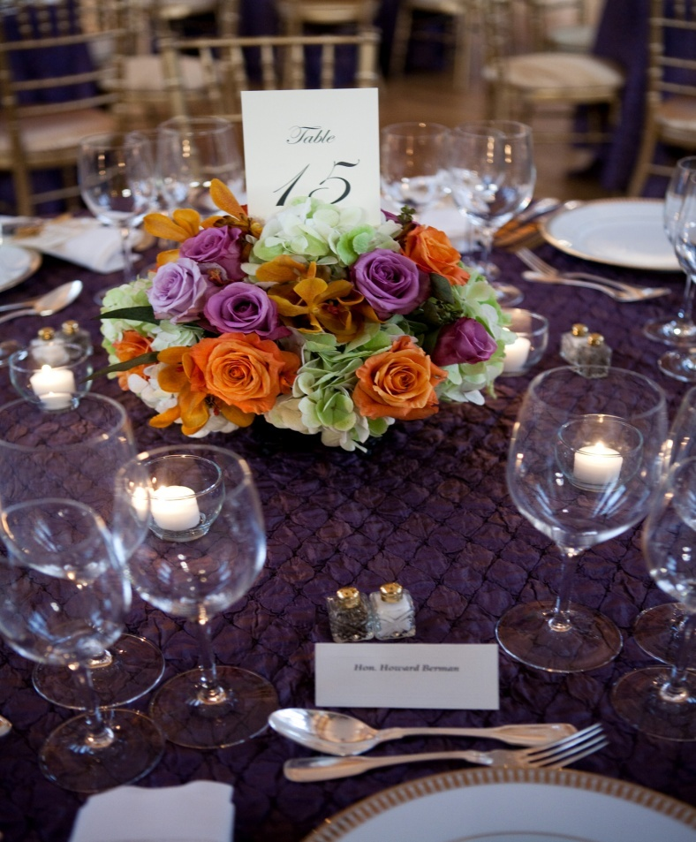
SUPPLIES at Events
Being prepared is vital!
Every Event you need the following:
Nametags – clip style name tags with donors first and last name on it. (only exception are some DC events where we are allowed to use sticky nametags)
ALL NP events must have clip name badges
Table # inserts – put on the back of nametags and note a guests table number. (see Example Krista is holding)
Table Tents – these are used for noting guests table seating arrangements and are placed on the tables of events (see pic)

Slide 42
Supplies at Events continued
Contribution forms – these are normally taken to all events and put on the registration table for guests to utilize as they arrive
Extra supplies – Nametags/ inserts/ table tents
Pens/ Black Permanent markers
RSVP List – this is VITAL – esp for larger events
Example: Napa/ NYC Issues Conference

Slide 43
Invitation Supplies
To send out an invite you will need the following supplies
Large Outgoing envelope
Small return envelope
5x7 invite card stock
4x6 return card stock
These supplies are located in the cabinets near Garner as well as by the interns desk. They go QUICKLY. It is Krista’s responsibility to order supplies – it is YOUR responsibility to let her know when you have a mailing coming up a week in advance so supplies can be ordered.

Slide 44
Invitation Supplies
NP letterhead
We use this for Thank You letters, mailings, and renewals. There is always some NP letterhead kept in stock in the front cabinets. When we have a LARGE mailing going out requiring this supply Katherine will gather the # that you will be sending and report the total amount that needs to be ordered to Krista.

Slide 45
The wonderful world of In Kinds
In Kinds are donations in which a donor personally pays for event related costs
In Kinds CANNOT be from corporations
In Kind donations per person cannot exceed $32,400 (2013) per calendar year
*Note: This includes any other donations that the donor may have made over the calendar year to the DCCC

Slide 46
In Kinds continued
Usage of Space – Payments
The DCCC must pay for all usage of corporate space unless the corporation offers the space to any outside group/community activity/fundraiser for free regardless of their pol. affiliation.
Note: this almost NEVER occurs.
The DCCC must pay for usage of corporate space at a fair market value rate (same as what would be charged to any other group)

Slide 47
In Kind paperwork
Hosts that choose to In Kind to an event/ or In Kind a service need to fill out specific paperwork and turn into Krista. (see example in binder)
This paperwork needs to be turned in along with receipts documenting the items that are being in kinded for the event.
This paperwork will be handed into Krista and delegated to the Regionals to process the same as any other monetary donation.

Slide 48
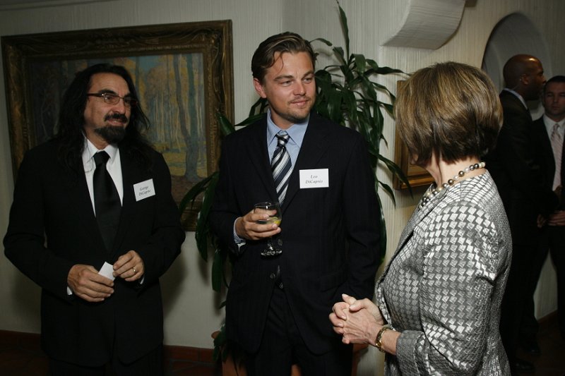
In Kind Examples
Ex: If Krista Dicaprio gave $20,000 to the DCCC in February of 2013 and hosted an event in May of 2013 she could ONLY In Kind event costs in the amount of $12,400.
In Kind donations can be split amongst donors/ or assigned to one person in particular as long as their donation does NOT exceed $32,400 per calendar year
Ex. If Leonardo and Krista Dicaprio host an event at their home and the total event costs are $10,000 they may each in kind $5,000 or one person may in kind the full costs.

Slide 49
In Home Hospitality
In Home Hospitality is a $2,000 per calendar year sum that is allotted to hosts of an event to spend on specific event related costs for events being held in their primary residence
This $2,000 is in ADDITION to the federal limit of $32,400 that a donor is allowed to give the DCCC
This $2,000 can ONLY be spent by the head of households in their primary residence on specific event related costs that include the following ONLY
CATERING (Food/ Beverages)
This can include wait staff and event rentals if it is blanketed under the overall catering bill
INVITATIONS

Slide 50
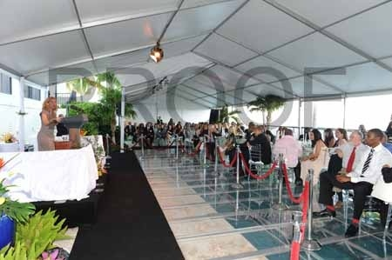
In Home Hospitality
Examples
Example:
If Krista’s 56 year old mother who lives with the Krista and Leonardo wants to spend $2,000 on event related costs – it CANNOT be considered In Home Hospitality as she is not the head of the household
Example:
If Krista and Leonardo Dicaprio host an event in their primary residence in Beverly Hills EACH person may spend up to $2,000 on event related costs (only including catering and invitations) in ADDITION to the $30,800 that they each donated to the DCCC.
Example:
If Krista and Leonardo Dicaprio’s 18 year old son wants to spend $2,000 on event related costs – it CANNOT be considered In Home Hospitality as he is NOT the head of the house hold
Example:
If Krista and Leo host an event at their summer home in the Hamptons they may NOT use the $2,000 per person In Home Hospitality allotment as it is NOT their primary residence

Slide 51
In Kinds Vs. In Home Hosp.
Catering
Event Rentals
Flowers
Invitations
Music
Valet Parking
Gift Bags
Catering
Can include wait staff & event rentals if included in the overall catering bill
Invitations
In Kinds
In Home Hospitality

Slide 52
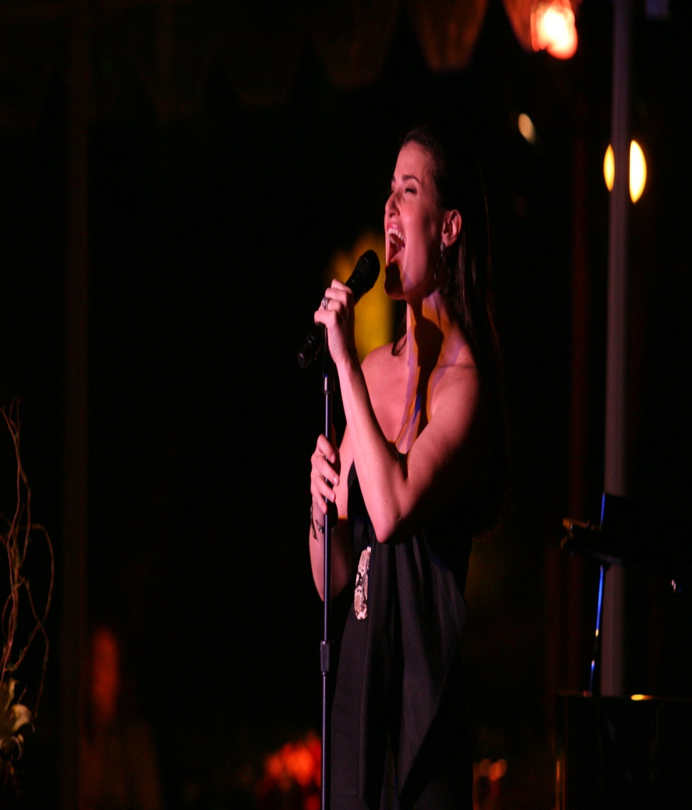
Talent Outreach
All talent requests need to go through krista
If you are interested in having talent at your event please speak to Krista
Note: TALENT IS EXPENSIVE!
There is a specific process that we go through in order to have talent approved/ vetted. Do not reach out on your own
This needs to be approved by Missy/ Stella first.

Slide 53
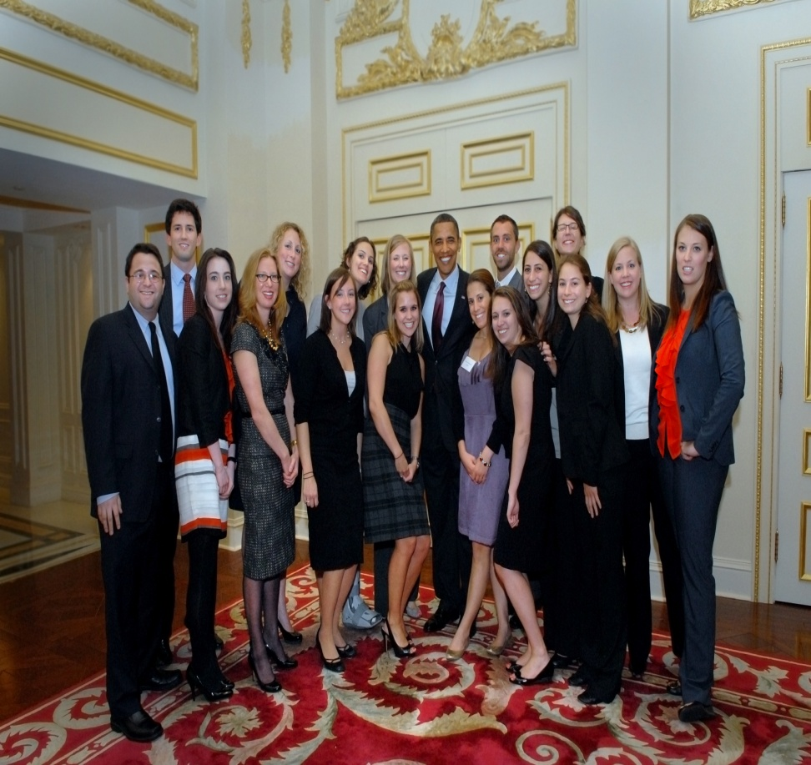
Staffing an Event
Staff plans
Staff Directions
Krista will create the staff plan for all large events
It is EXTREMELY important to review this, follow this, and ask questions in advance of the event
For all large events Krista will have pre event meetings and walk throughs

Slide 54
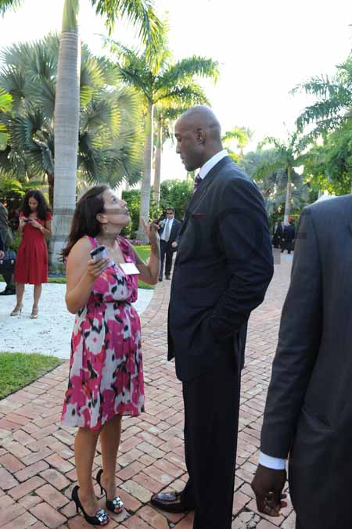
At an Event Remeber. . .
Listen to directions
You are representing the DCCC – be professional at all times
If you have a question/ concern please find Krista – do NOT make changes- or adjustments w/o approval
Be ON TIME – if staff plan says arrive at 6:00pm – 6:05pm is LATE
Look Alive – people attend events and expect to have a good time – seeing DCCC staff is first impression that get

Slide 55

Travel Expenses
Per Diem
All cities (with the exception of the ones listed below) are at a Per Diem Rate of $44/day.
In the following cities the per diem are $68/day
San Francisco
Los Angeles
Boston
New York
Chicago

Slide 56
Invitations – Krista Portion
If you have an upcoming event- loop in Krista so she can begin the invitation design process
Note: During busy times this can take 24 hours
The following is the information you need to provide Krista with…
Members of Congress involved: Congressman Henry Cuellar
Democratic Leader Nancy Pelosi
Type of Event: Reception
Time: 5:00pm – 6:00pm – VIP
6:00pm – 7:00pm General
Location: La Posada Hotel
1000 Zaragoza Street Laredo, TX 78040
Price points: $1,000/person; $10,000/person; $30,800/couple
RSVP: Laura Rose – (202) 485-3418 – lrose@dccc.org

Slide 57
Invitations – Krista cont…
Once Krista has designed a template for your invitation she will send back to you (Regionals)
From there on you will follow the invite approval process outlined by Katherine
NOTE: it is VERY important to let Krista know of any changes made by legal/ Crider – so those can be reflected on the resized invites that will be mailed out – so everything is UNIFORM
Once the Final Invite has been edited, always email it to Krista and Katherine so they can save in the proper files

Slide 58
Briefings
The Most Heinous Part of Your Job

Slide 59
Briefings
Background:
One of the reasons Leader Pelosi, Chairman Israel, and other members of the Caucus continue to be actively involved in our fundraising programs is because we do such a thorough job preparing them for meetings and events, and making it easy for them.
The purpose of briefings is not to simply “check a box,” but to let the Member know what they are walking into and why.
While briefings are a lot of work, they are literally worth their weight in gold, and more importantly, must be done.
Remember- briefings are a formula; once you get the hang of it, they will be a piece of cake.

Slide 60
Leader Pelosi Briefings
Materials Needed (Events):
Main Briefing
Attendee Briefing
Table Card (if seated dinner)
Timeline Card
Acknowledgement Card
Talking Points (Communications)
Political Memo (Political)
Thank You Memo
Materials Needed (Meetings):
Main Briefing
Meeting Card

Slide 61
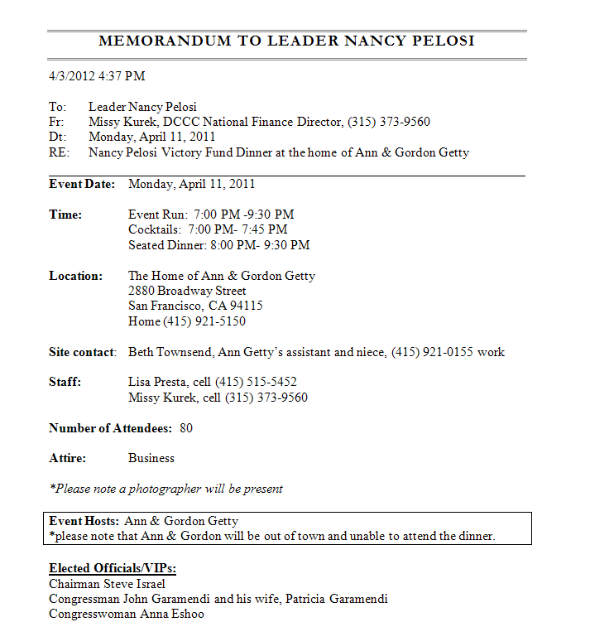
NP Event Main Briefing

Slide 62
A few things…
Include Event Time
Time: Event Run: 6:30 PM -8:30 PM
Cocktails: 6:30 PM- 7:30PM Seated Dinner: 7:30 PM- 8:30 PM
Confirm any phone numbers that are on the Briefing
Example: Site contact: Jared Miles, (415) 921-0155 Home
Cell (415) 830-2451

Slide 63

A few more things…
Indicate if photographer will be present
*Please note a photographer will be present
MAKE SURE hosts are in box on front page of briefing

Slide 64
Family & VIPS
Include all VIPs and Family who are attending/ Invited
Elected Officials/VIPs:
Congresswoman Anna Eshoo
Congresswoman Zoe Lofgren & John Marshall Collins
Congressman Jerry McNerney
Congressman George Miller & Cynthia Miller
Congresswoman Jackie Speier & Barry Dennis
Congresswoman Barbara Lee (Cocktails only)
Mayor Willie L. Brown, Jr.
Hon. Jerry Brown & Anne Gust Brown
Paul Pelosi
Paul Pelosi, Jr.
Christine Pelosi & Peter Kaufman
*Please note that Rep. Mike Thompson, Sen. John Burton, Mayor Gavin Newsom and Margaret & Richard Jacobsen were invited to the dinner, however, they are unable to attend.

Slide 65
Background Portion
Be sure to include
Ticket Price- The ticket price is $30,800/couple to attend.
How much this event will raise- We expect to raise $1,000,000 for this event.
If annual event, date of last years event- The Getty dinner last year was held on Thursday, February 21st, 2008.
Number of guests- Approximately 90 guests will attend cocktails and dinner.
Event set up, i.e., mix and mingle cocktail reception, seated dinner, VIP reception, etc. - There will be an hour cocktail and mix & mingle period when guests arrive, followed by a seated dinner.

Slide 66
Finally
Include the timeline of events
Timeline of Events/Speaking Program:
6:30 PM Event begins
6:30 PM You arrive and mix and mingle
7:30 PM Seated dinner begins
7:45 PM Gordon Getty welcomes guests, introduces Congresswoman Anna Eshoo
7:50 PM Congresswoman Eshoo welcomes guests and recognizes Members & VIPS
8:00 PM Entrée is served
8:05 PM Congressman George Miller introduces you.
8:10 PM You make brief remarks.
8:30 PM Event concludes, you depart

Slide 67
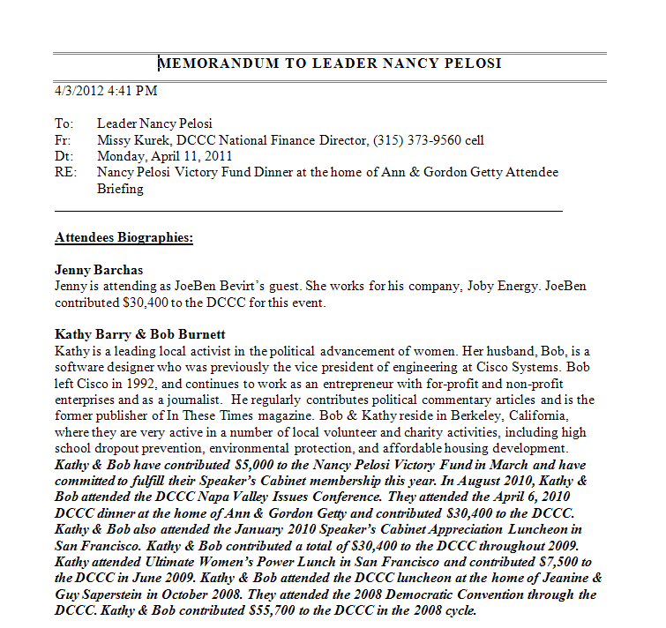
NP Attendee Briefing (or 2 liners)

Slide 68
Attendee Biographies
Be concise- Include employer, occupation, boards they may be on, etc.
Bold and italicize the amount they are contributing to event, last contribution to the committee, and past events they attended. Be sure to include if person attended Inauguration, Convention, Napa Valley Weekend, etc.

Slide 69
Example
Joseph Cotchett
Joe is considered by plaintiffs and defense attorneys alike to be one of the foremost trial lawyers in the country. He has been named one of the 100 most influential lawyers in the nation for the past 10 years. He has built a career out of representing the underdog against powerful interests. Joe and his family are active in numerous Bay Area charitable organizations involving animals, children, women and minorities. They established the Cotchett Family Foundation that aids individuals and groups in need of assistance. Joe raised $200,000 in the 2008 cycle for the DCCC, as well as personally contributed $28,500. Joe attended the Democratic National Convention in Denver with the DCCC, as well as the DCCC’s Inaugural Activities in January 2009. Joe contributed $30,800 for this event.

Slide 70
Things that may not seem big, but have led to blow ups
Misspelled Names
i.e. Huneeus vs. Hueenus
First one is correct, second one ended up on the briefing, and things got ugly.
Missing Spouses
If spouse cannot attend, please indicate on briefing instead of just leaving it off.
Bad Grammar
Print out the briefing and read through it to look for missing words, punctuation, etc.

Slide 71
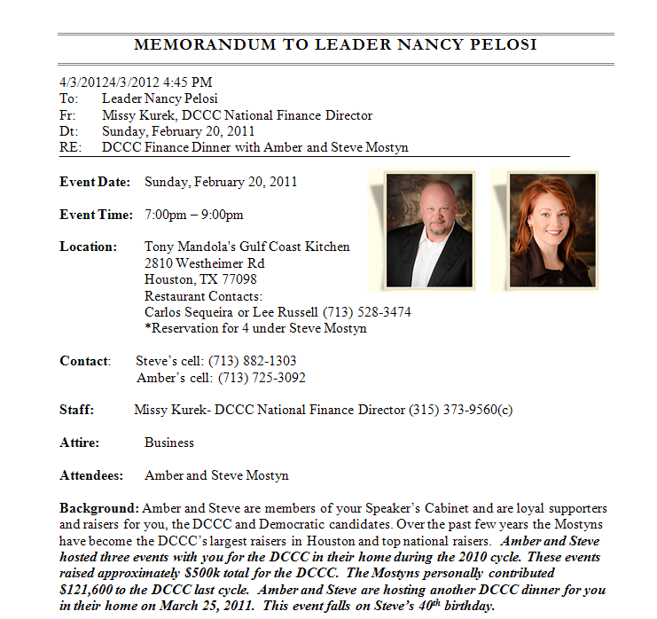
Meeting Briefings

Slide 72
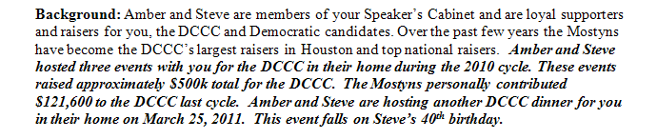
What to Include
Photo of person meeting with NP
Background information- last event they attended, previous DCCC Participation, if they requested meeting

Slide 73

What to Include Part II
Ask
Attendee’s biography
Detailed Giving History

Slide 74
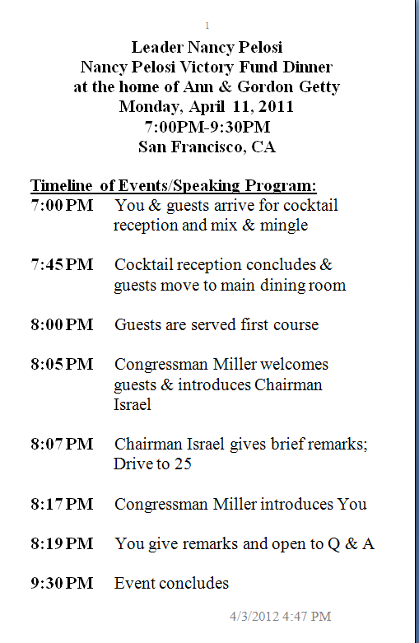
Event Cards-Timeline Card

Slide 75
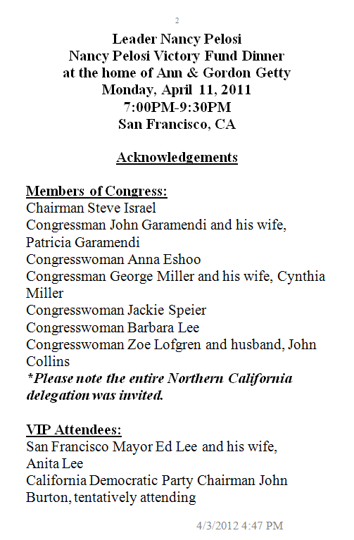
Acknowledgement Card

Slide 76
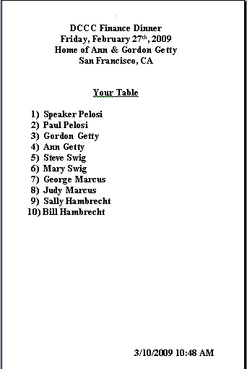
NP Table Card

Slide 77
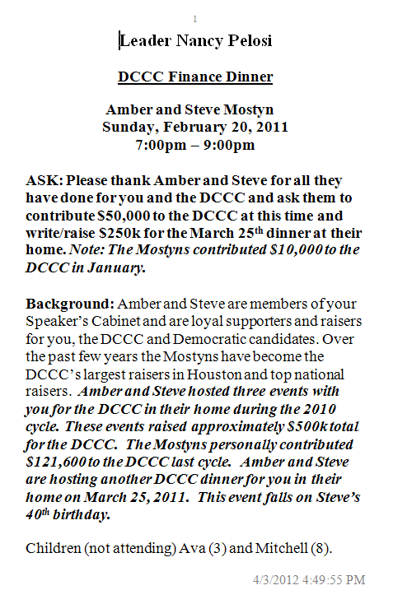
Meeting Card

Slide 78
A few things about cards
Always print 4 or more copies- 2 for NP, and additional for staff
Double check spelling
Always bring extra cards to events

Slide 79
NP Thank You Memos
What to Include:
Event Hosts, Co-Hosts, and Major Raisers
Always include spouse names
Include children’s name if they attended
How much Hosts Co-Hosts, and Major Raisers contributed or raised for the event
The total amount the event raised
Any Members who hosted or attended the event
How much a Member raised for the event and/or if he/she made a dues contribution towards the event and how much
When an orchid was sent/ will be sent to host(s)
When a Thank You note was sent/ will be sent to Member(s)
As many phone numbers as possible, listed in preferred order

Slide 80
NP Thank You Memo
Tuesday, October 19, 2010 Boston, MA DCCC Women LEAD Luncheon hosted by Congresswoman Niki Tsongas, Vicki Kennedy and Ambassador Swanee Hunt
Congresswoman Niki Tsongas
Cell: (978) 555-5555
Please call and thank Congresswoman Niki Tsongas for hosting the Women LEAD Luncheon on Tuesday, October 19 and for raising $25,000 for the DCCC.
This event raised $50,000 for the DCCC.
Congresswoman Tsongas made a $5,000 dues contribution towards this event.
A thank you note was mailed to Congresswoman Tsongas on your behalf on October 20, 2010.
Vicki Kennedy
*Cell: (202) 555-5555
Home: (857) 555-5555
Please call and thank Vicki Kennedy for co-hosting the Women LEAD Luncheon on Tuesday, October 19 and contributing $5,000 to the DCCC for this event.
This event raised $50,000 for the DCCC.
An orchid was delivered to Vicki on your behalf on Wednesday, October 20, 2010.
Ambassador Swanee Hunt
*Work: (617) 555-5555
Home: (617) 555-5555
Cell: (857) 555-5555
Please call and thank Ambassador Swanee Hunt for co-hosting the Women LEAD Luncheon on Tuesday, October 19.
This event raised $50,000 for the DCCC.
An orchid will be delivered to Swanee on your behalf on Wednesday, October 20, 2010.

Slide 81
NP Thank You Memo
Once you have collected all of the needed information for the TY memo, and it has been approved, email it to Johana, who will compile it into the Master NP TY Memo
Johana will track which calls have been made and which are still outstanding
NOTE: TRIPLE CHECK YOUR NUMBERS!!!!
Courtney has a list of all MOC cell numbers, so please ask him for the MOC cell if you do not have it

Slide 82
NP Briefings-
Katherine will send around a list of materials needed for events and when they are due.
Once you have FINAL, APPROVED versions of all of your materials, email the following to Kellie:
NP Main Briefing
NP Attendee Briefing
NP Cards
Kellie will already have:
Talking Points (from Comm)
Political Memo (from Political)
TY Memo

Slide 83
NP Briefings-
Kellie will then email all of the Final items to NP’s office
All of this also needs to be sent to Kellie for…

Slide 84
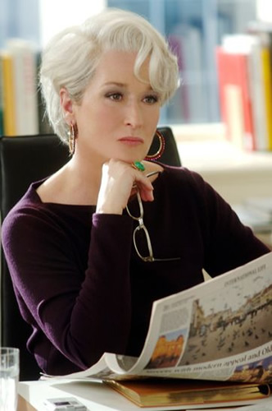
“The Book”
2 copies of the following: (Regional)
Main Briefing
Attendee Briefing
Event Cards (timeline, acknowledgements, table card)
Talking points
Event Spreadsheet
Political Memo
Thank You Memo
1 copy of the following: (Katherine)
Long Term
Block Calendar
Finance Plan
Snap
*Include 5 or 6 extra cards – blank

Slide 85
Chairman Israel Briefings
Materials Needed (Events):
Main Briefing
Attendee Briefing
Table Card (if seated dinner)
Timeline Card
Acknowledgement Card
Talking Points (Communications)
Political Memo (Political)
Thank You Memo
Materials Needed (Meetings):
Main Briefing
Meeting Card

Slide 86
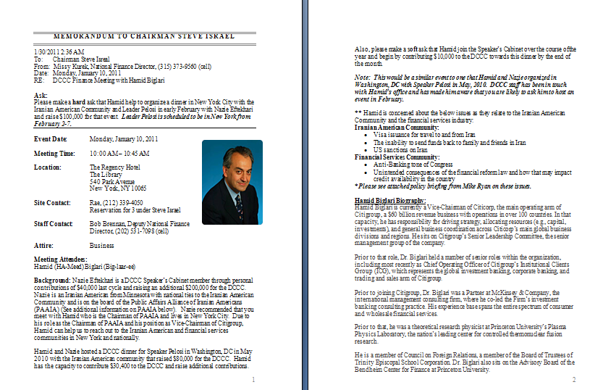
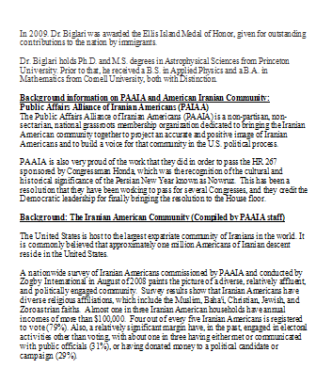
Chairman Israel Briefings

Slide 87
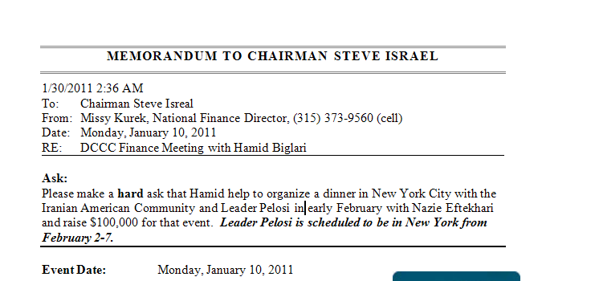
Chairman Israel Briefings
The most important difference: THE ASK

Slide 88
Chairman Israel Briefings
Kellie will send around a list of materials needed for events and when they are due.
Once you have FINAL, APPROVED versions of all of your materials, email the following to Hayley:
SJI Main Briefing
SJI Attendee Briefing
SJI Cards
Hayley will already have:
Talking Points (from Comm)
Political Memo (from Political)

Slide 89

Part Two: The Money You Raise
How to not screw this up

Slide 90
WHERE DOES OUR MONEY COME FROM????
MISSY KUREK: DEPUTY EXECUTIVE DIRECTOR
STELLA ROSS: NATIONAL FINANCE DIRECTOR
National Individual Donor Program, Member Dues, PAC, and DC Individual
TARYN ROSENKRANZ: DIRECTOR OF MARKETING AND NEW MEDIA
Online and Direct Mail Money

Slide 91
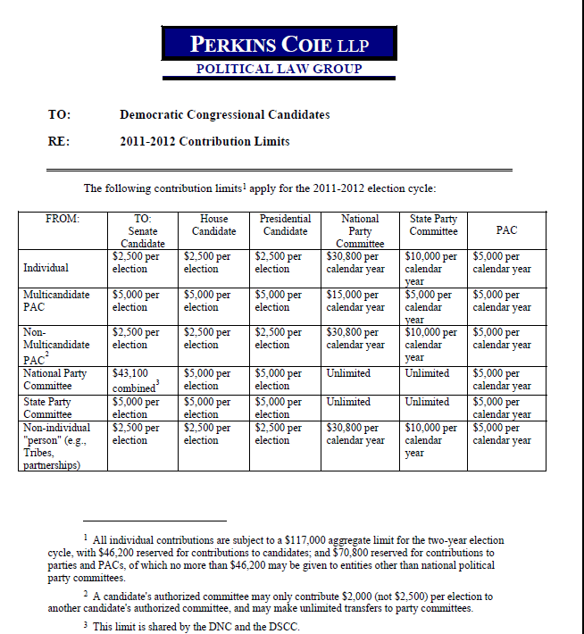
PARTY GIVING LIMITS

Slide 92
FINANCE DONATIONS
The Money You Raise

Slide 93
Hard Commits
Once you have a pledge that you feel confident will come in (someone said they were putting it in the mail), add it as a “Hard Commit” in your money in spreadsheet, and send to Katherine as “Region Hard Commit”
Hard Commits are counted like actual, spendable money in the nightly income “snap” that Katherine sends out to senior staff each night, so please keep that in mind when sending (or not sending) Hard Commits

Slide 94
What happens to money that comes in?
Money comes into the committee various ways:
Via mail, at an event, from a Member, via UPS or Fed Ex, via Fax, over the phone, online, or via email. No matter how it comes in, you should immediately give to Katherine to copy and give back to you. You should never hold actual checks at your desk. And if you get a credit card contribution off the fax machine, or take a credit card over the phone, you should always give it to Katherine before you do anything with it
Once Katherine has the actual contribution, she will log it, copy it and all accompanying documentation, and let you know if it is a problem check or not, and what to do with it. She will give the copy to the Regional Director, who will then write on the copy 1. Which Event it is to be credited to and 2. Member Credit. He or She will then give to the appropriate person to process.

Slide 95
Processing Money Once you Receive It
Money should be processed IMMEDIATELY after the check copy is received. When you receive a high volume of checks, it is totally understandable to not get them all processed immediately, but you should never leave for the day without processing your checks. If you need help, ask Katherine, and she will find it for you. Do not ask someone from another region to help you, because chances are, they have something higher on their priority list at the moment. Katherine will find the most appropriate people to help.
*Note: NO ONE in Finance is above processing a check, and there will be times when any one region has literally over one hundred checks to process, and they will need help, so if you do not know how to process checks in NGP, pay attention to the next part. It is not that hard.

Slide 96
Sending Money In
Katherine will send an email at the end of the day asking for Money In and Commits. At this point, you should send up your money in for the day in an email with the subject line, “Region Money In.” CC Missy, Lindsey, and your team on this email.
When you send money in, you should only show the NEW money received that day. However, at the bottom of your spreadsheet, it should have your monthly total as well, so Katherine can check it with what she has and make sure the numbers match.

Slide 97
Online Money
Katherine will check all of the Finance websites periodically to see if anyone has contributed online. If they have, she will give you a print out from Authorize.net, and you process it like a credit card contribution. Online contributions ALWAYS have to be processed for the “Submit Date” on the print out, with no exceptions. Note: these contributions have to be processed IMMEDIATELY, as that is money that is already in the bank. If you do not process these immediately, you will have to face the wrath of Milly by way of me. Just try it once and you’ll know what I’m talking about.
If you are expecting a contribution online, you can ask Katherine to be on the lookout for it. If you suspect they might go onto the regular website to do it, please tell me so I can give Taryn and her team a head’s up. However, it is beneficial for everyone if you make your absolute best efforts to make sure that your donors DO NOT go onto the regular website to contribute. And if they contribute in response to an email sent from Online, you will not receive credit for the contribution.

Slide 98
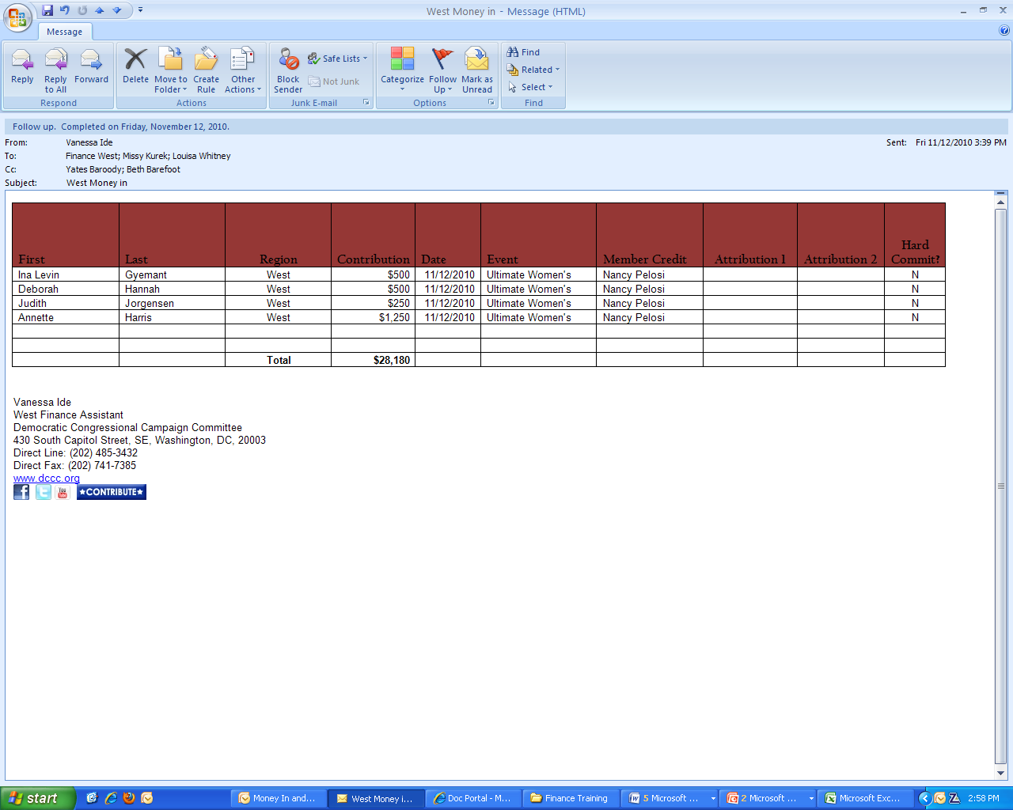
Tracking and Sending Money In

Slide 99
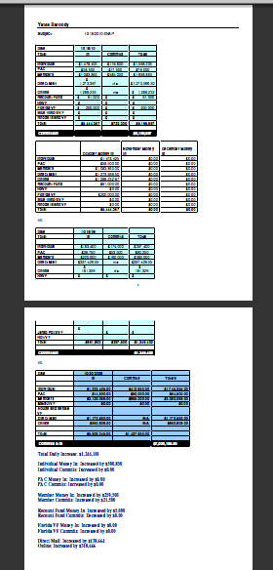
The SNAP
Why sending money in and commits is important
The SNAP is a daily snapshot of where the money is for the committee
This is sent every night to Robby, Jackie, Kristie, Beth, Lindsey, Missy, Jenn, and Taryn, which shows where we are for the Quarter, and the Month
This is what Accounting bases spending off of, and what they check their numbers against
Which is WHY it is so important that you have any money that you put in the snap processed, because otherwise, my numbers will not match Jackie’s
THE SNAP HAS TO BE 100% CORRECT EVERY SINGLE NIGHT. AND HARD COMMITS COUNT AS SPENDABLE INCOME

Slide 100
Problem Checks and where they fall into all of this
Problem Checks DO NOT count as Money In, and if a check comes in that is a problem that was also in hard commits, it must be removed from hard commits, and put into a third section called, “Problem Checks.” These are tracked completely separately, and are not counted in the snap. And if a credit card contribution comes back declined, you should move it over to problem checks if you are not able to get it resolved within the day.
Note: Missy and Lindsey will literally email me every single day and ask for a list of Hard Commits and Problem Checks, and they will then go to each one of you and ask you where they stand, so I suggest you keep a record of all of your progress with problem checks, and that you know when your hard commits were put in the mail.
Once you get a problem check resolved, not only will you feel like you just saved the world, you should also note it in your money in email. This can just be a note in the bottom of the email, but you just need to make it clear that you have resolved it.

Slide 101
What Date to Process Money For
In a perfect world, money would always be processed the day it was received. However, there are a few caveats to that. For example, legally a check has been “received” the day it was received by an “agent” of the committee (aka a consultant, etc). Therefore, the date received can be tricky. Katherine will generally stamp your contribution with the received date, and that is the date you should process it for
Vets
You should process vetted contributions for the day the vet comes back
Problem Checks
You should process problem checks for the day the check was resolved UNLESS otherwise noted.

Slide 102
Contribution Vets
Which contributions need to be vetted?
Contributors giving $5,000 and up
Contributors whose donation aggregates their giving to $5,000
Contribution vets are valid for exactly one year
Note: An Individual’s vetting status is recorded in NGP. Always check the Status before sending up a vet. If it says “Passed,” they are good and you do not need to send a vet. If it says “Expired” or “Not Vetted,” you must send a vet

Slide 103
How to Send a Contribution Vet
Subject: Contribution Vet: Katherine O'Koniewski
Note: Jackie and Katherine both have “vet” folders. You MUST include the word “vet” in the subject or it will get lost in space
Body:
Name
Address
Contribution Amount
Employer
Occupation
Giving History (2011-2006)
Send to: Jackie, cc Beth, Katherine, and your team
NOTE: The Employer/Occupation in the vet must match what is in the donor’s NGP record

Slide 104
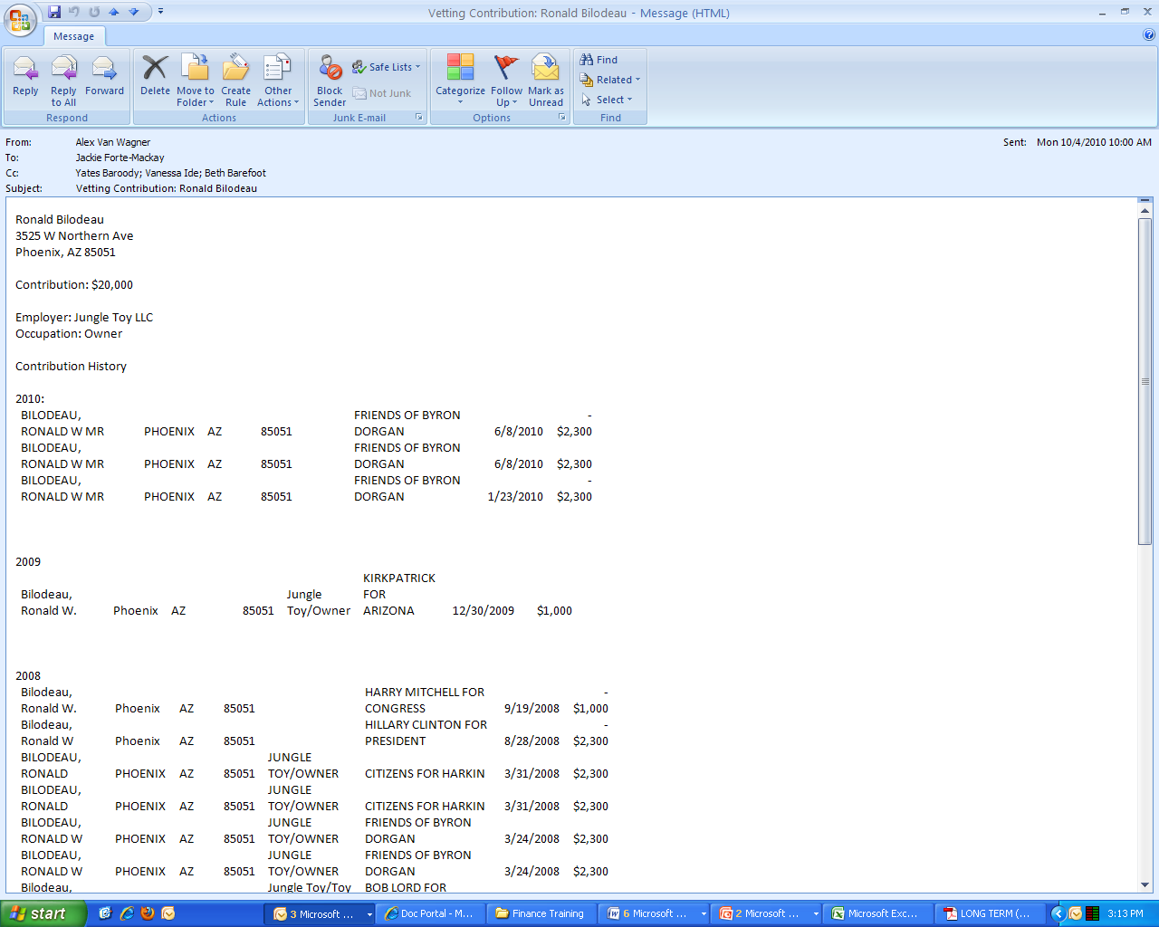
Contributor Vet Example

Slide 105
Contributor Vets Ctd.
Contributions being vetted are not to be processed until you receive an email back from Jackie that says, “Ok.” As soon as you receive this email, you should process the contribution
Always write, “Vetted on 2/1/2011” in the “notes” section of your transmittal; this helps Jackie and Katherine a lot
Do not wait to send contribution vets. This holds up the amount of time it takes for the money to actually get in the bank, and we do not want that
Contributions from PACs, Members, and Tribes do not have to be vetted

Slide 106
How to Process Money
INDIVIDUAL – Vanessa
PAC and Members – Brian

Slide 107

HOW TO PROCESS A CHECK
Please take out your umbrellas
because it’s about to rain.
Alex Van Wagner

Slide 108
To Start
1. If this check is NOT a problem check…
-go to NGP
-But if Katherine tells you it is a problem…

Slide 109

DO NOT PROCESS PROBLEM CHECKS

Slide 110
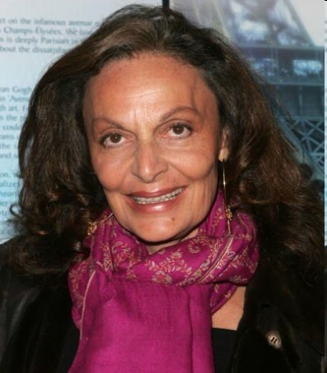
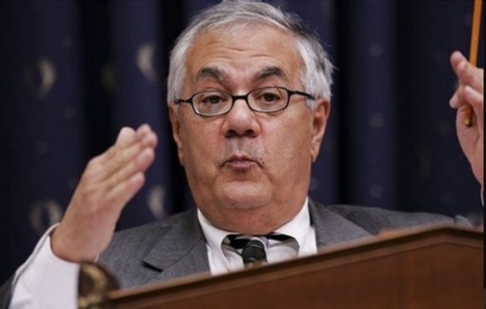

START BY ASKING THESE QUESTIONS…
2. Who did we trick into giving us money?
- Different types of contributors =
different ways of processing money
INDIVIDUALS MEMBERS PACs

Slide 111
START BY ASKING THESE QUESTIONS…
3. What event is the money going towards?
4. Which MOC is getting credit?
Different events will have lead MOCs
Some members will raise for other MOCs’ events.

Slide 112
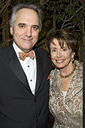
PROCESSING CHECKS FROM INDIVIDUALS

Slide 113
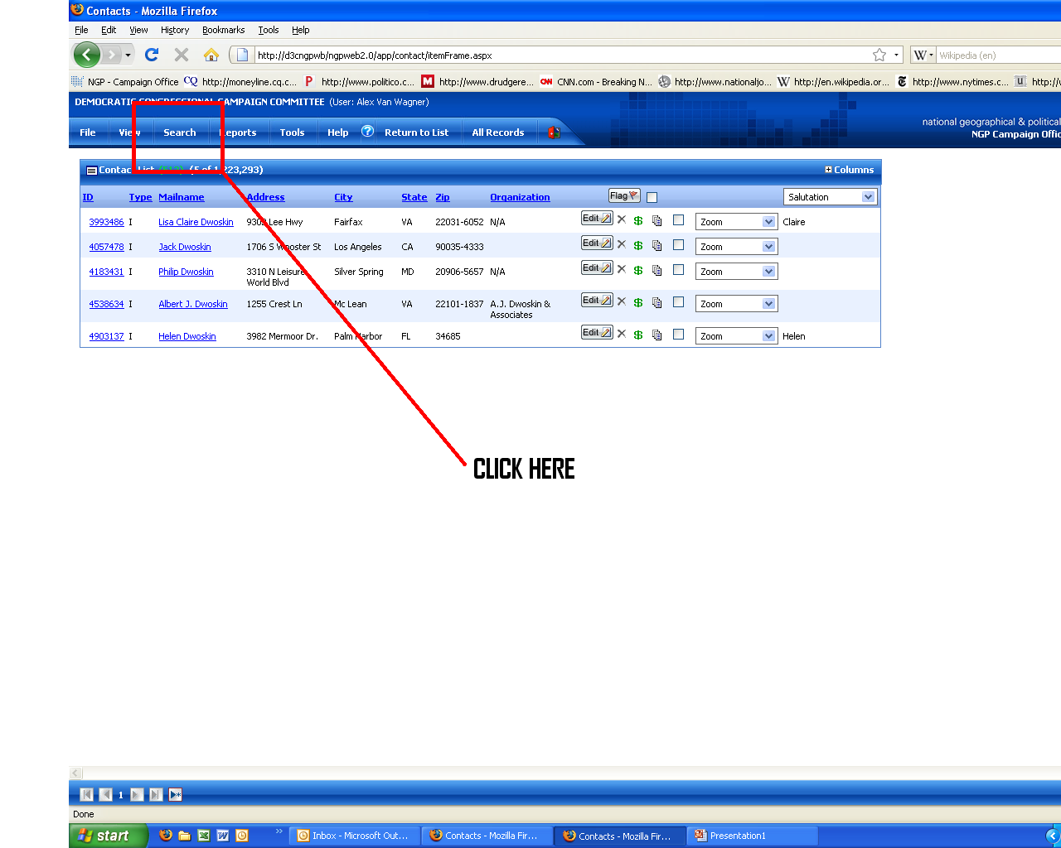
STEP 1: Who’s the Contributor?
Go into NGP
Go to the Search Option, and select “Quick Find”
This can also be done by clicking “Ctrl + Shift + F”

Slide 114
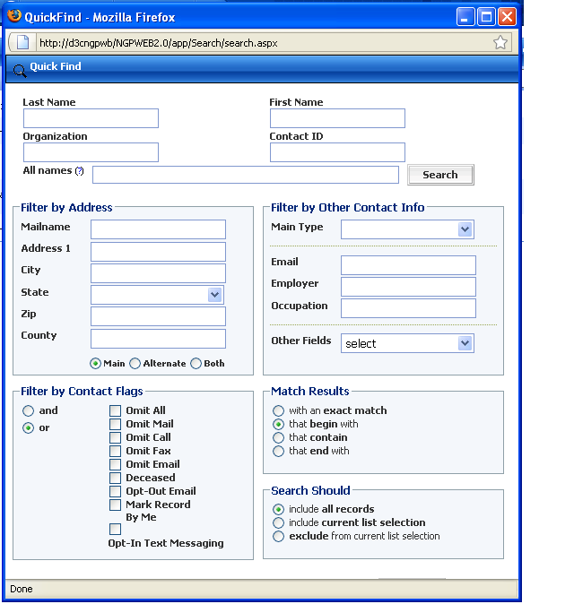
STEP 1: Who is the Contributor?
Use the full name of the contributor

Slide 115
STEP 1: Who is the Contributor?
If you get 1,000 Michael Smiths, use their address
Addresses are the best way to search for PACs and Member Campaign Committees

Slide 116
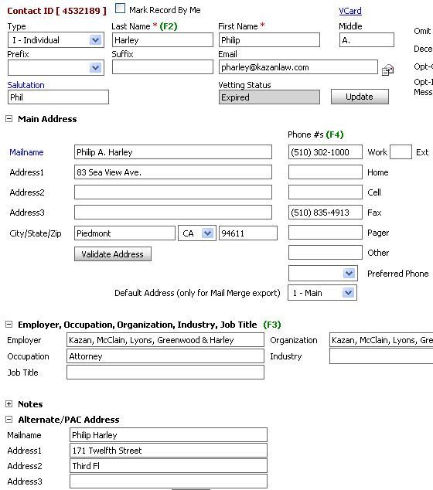
STEP 2: THE CONTACT RECORD
MAKE SURE ALL CONTACT INFORMATION IS CURRENT
The name MUST be the full name, and match what is on check or credit card

Slide 117
STEP 2: THE CONTACT RECORD
Make sure the main address listed is the billing address
RECORDS PULL FROM MAIN MAILING ADDRESS

Slide 118
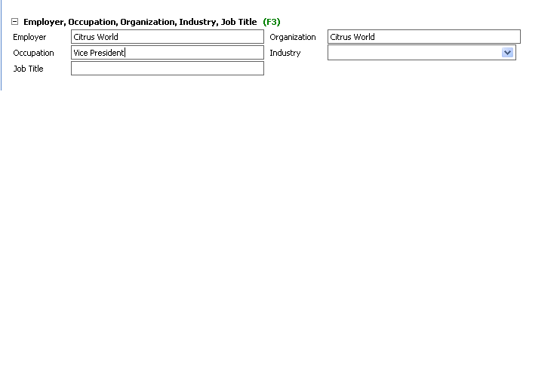
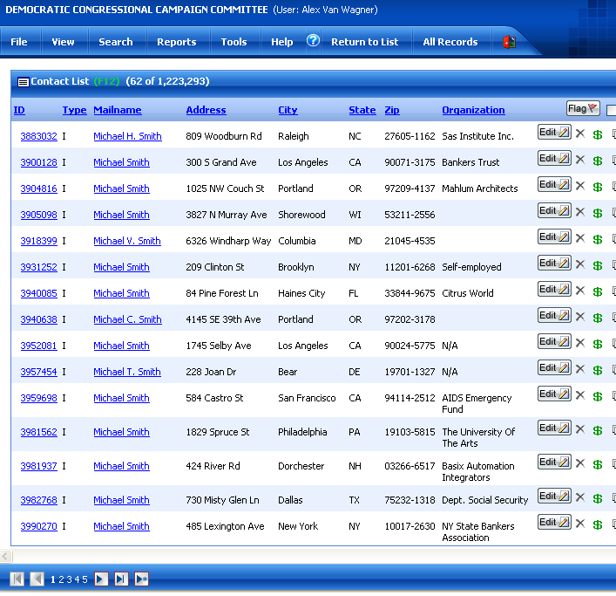
STEP 2: THE CONTACT RECORD
People get quit or get fired. Make sure you keep the employer/occupation up-to-date
Copy + Paste the employer into the organization box.
This helps when doing a search for someone like Michael Smith who works at Citrus World

Slide 119
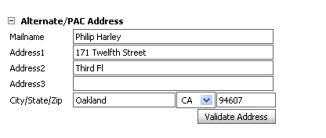
STEP 2: THE CONTACT RECORD
ALTERNATE ADDRESS
Keep track of every address you have for the individual
Mailing address is not necessarily billing address

Slide 120
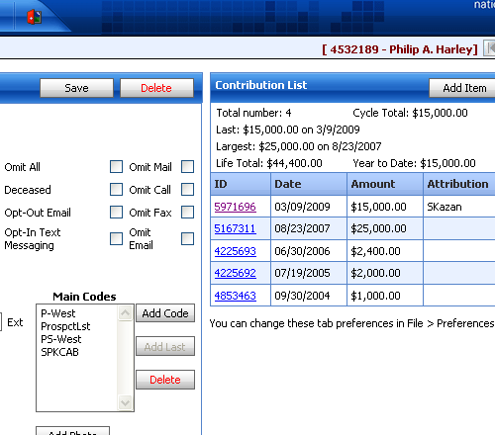
STEP 3: ADDING THE CONTRIBUTION
Time to make it rain
Click “Add Item”

Slide 121
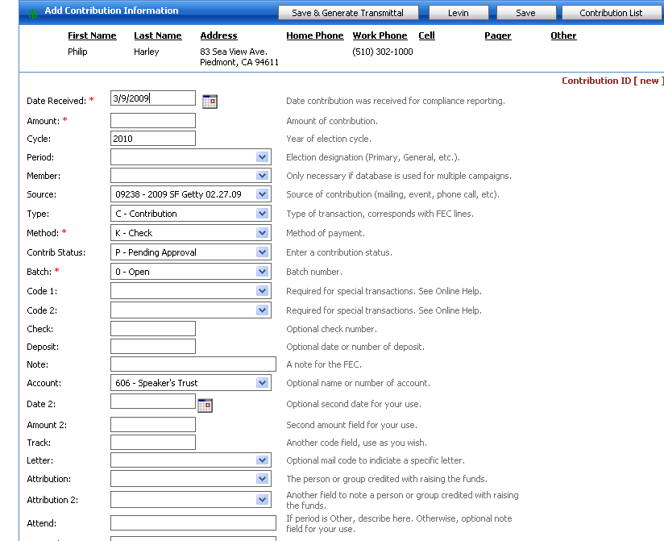
STEP 3: ADDING THE CONTRIBUTION
DATE RECEIVED
Make sure the date stated in this box is the date you received the contribution
AMOUNT
Make sure this amount is correct, if it’s for 5k, write “5,000”, no need for the $ sign

Slide 122
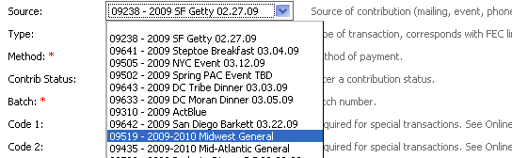
STEP 3: ADDING THE CONTRIBUTION
SOURCE
This is SUPER important
Make sure your source code matches what the check was raised from
If the code does not exist yet, email Katherine

Slide 123
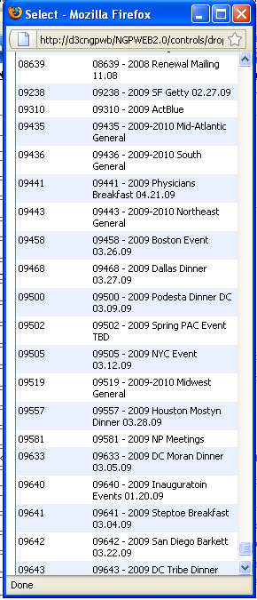
STEP 3: ADDING THE CONTRIBUTION
Every contribution MUST have a code
Click “more” if code is not on scroll-down
The new box that pops up is searchable, press “ctrl + f” to search for “Getty” or “NYC Event”

Slide 124
STEP 3: ADDING THE CONTRIBUTION
METHOD
Indicate if it’s a check or a CC
If check, write the check number in box
ACCOUNT
Individual checks need to go in “606 Speaker’s Trust”
DO NOT mess this up

Slide 125
STEP 3: ADDING THE CONTRIBUTION
ATTRIBUTION 1 or ATTRIBUTION 2
If someone is responsible for raising the contribution and we are crediting them internally, they must receive an Attribution Code
Attribution 1 = Non-Lobbyist
Attribution 2 = Lobbyist
ENGRAIN THIS IN YOUR BRAIN

Slide 126
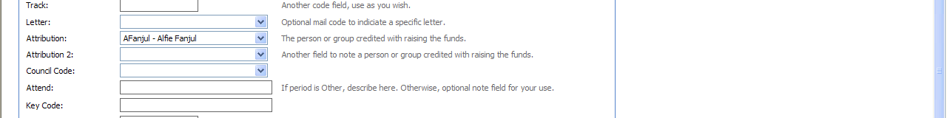

Attribution 1 = NON-LOBBYIST
If the Individual or Entity you are crediting the contribution to is NOT in the drop down menu in NGP, ask Katherine to create an Attribution 1 Code for this Person/Entity
Note: The Individual or Entity MUST have a current record in NGP in order to create this code, so always send Katherine the Contact ID when asking to create an Attribution 1 Code

Slide 127


Attribution 2 = LOBBYIST
If the Individual or Entity you are crediting the contribution to is NOT in the drop down menu in NGP, ask Katherine to create an Attribution 2 Code for this Person/Entity
Note: The Individual or Entity MUST have a current record in NGP in order to create this code, so always send Katherine the Contact ID when asking to create an Attribution 2 Code

Slide 128
ATTRIBUTIONS
You MUST include screenshots with your raised contributions, proving that the Individual/Entity is a Lobbyist or is NOT a lobbyist
Lobbyist Raised Contributions are printed on Hot Pink Paper always

Slide 129

STEP 3: ADDING THE CONTRIBUTION
TALLY MEMBERS
Click “tally members” box, new window will pop up
Tally Region and MOC
Each should be attributed 100% of the contribution
This is where Brian will pull how much a member raises
Also allows region to pull their contributions
THEN CLICK CLOSE AND WOOOOOOOO YOU’RE (ALMOST) DONE!

Slide 130


STEP 4: THE CHECK COPIES
If the contribution disappears, click “contribution”
Then select what you just processed and click “Zoom” on that contribution

Slide 131

STEP 4: THE CHECK COPIES
Click
“Save & Generate Transmittal”

Slide 132

STEP 4: THE CHECK COPIES
New Screen will pop up
Click Adobe Acrobat pdf
Click export

Slide 133

STEP 4: THE CHECK COPIES
The NGP Cover sheet will pop up
Verify that all information is correct
Initial where it says “Processed By:” and check off boxes
Print two copies, give one to Katherine, keep one for your records

Slide 134
PAC Contributions
When searching for their contact, use
“mail name”
“address 1”

Slide 135

PAC Contributions and how they’re different
Make sure the PAC has an FEC number in contact record
Use www.tray.com to find
Process like an individual contribution
Instead of Account 606, make sure the contribution is placed in
“602 – DC (Speaker’s Club)”
Print two copies, one for Katherine, one for your records

Slide 136

MEMBER DUES
Search by the Member’s first and last name. Member records should be type ‘C’ in the search results (the actual record says type ‘A’ – we don’t know why).
IMPORTANT – The contribution does NOT go to the Member’s personal record. It goes to their Campaign (or Leadership PAC) which is found under the ‘Links.’

Slide 137

MEMBER DUES
Most Dues checks are ‘Unlimited Transfers.’ For these, the ‘Type’ is ‘O-Other Miscellaneous’ and the ‘Code 1’ is ‘NT-Non memo-ed note.’ You also need to write ‘Unlimited Transfer from Principal Campaign Cmte.’ in the ‘Note’ section.
Some Dues Checks are ‘Contributions.’ They are ‘C-Contribution’ with no ‘Code 1.’ You also need to write ‘Contribution’ under ‘Note.’
Member Dues are Account 607 (Leadership PACs are 617 and processed in the same manner as other PAC checks).

Slide 138
Problem Checks
Daniel Berger’s 15k and beyond

Slide 139
Problem Checks
The FEC has strict guidelines on what constitutes “permissible funds” … and Jackie has even stricter ones.
Donations can be deemed “problems” for numerous reasons, and most require us to obtain additional documentation to accompany the contribution
The following are different scenarios of typical “problem checks” and how to resolve them

Slide 140
Problem Checks and the 10 Day Deposit Rule
Per FEC regulations, we have 10 days from receipt of a contribution to deposit that contribution
In other words, you have 10 days to get your problem checks resolved, or they must be sent back

Slide 141
Problem: Contributor Clearly did not sign the check
Legally: A contribution is attributed to the individual signing the check. If the campaign receives a contribution that is clearly from one individual, but signed by another, it should obtain from the actual contributor a signed statement that he or she made the contribution. This can happen when, for example, an individual has an accountant or secretary sign a check. This also applies when a husband’s name is on the check, and a wife (whose name does not appear on the check) signs the check, and vise versa.
If the Donor gives you a hard time about this:
Per the Code of Federal Regulations Title 11, Chapter 1, Part 104.8 (C), “Absent evidence to the contrary, any contribution made by check, money order, or other written instrument shall be reported as a contribution by the last person signing the instrument prior to delivery to the candidate or committee.”

Slide 142
Problem: Contributor Clearly did not sign the check
Letter:
Katherine O'Koniewski
2414 Tunlaw Rd, NW
Washington, DC 20007
Dear Ms. O'Koniewski,
Thank you for your recent contribution of $_______ to the Democratic Congressional Campaign Committee: Check No. _____ dated ________.
Federal law requires that when a check used to make a contribution is signed by someone other than the contributor, that the check must be accompanied by evidence indicating that the contributor intended to make the contribution. Since the above-mentioned contribution did not contain your signature, we would appreciate it if you could sign the enclosed form which confirms your contribution for our records in accordance with federal law.
Please return the form in the enclosed envelope provided. If you have any questions, please do not hesitate to contact ________________ at (___) _____________________.
(See response form next page.)

Slide 143
Problem: Contributor Clearly did not sign the check
Form:
CONFIRMATION OF PERSONAL FUNDS
Katherine O'Koniewski
2414 Tunlaw Rd, NW
Washington, DC 20007
This confirms that I contributed $20,000 from my personal funds, and not from any incorporated source or account, to the Democratic Congressional Campaign Committee on January 1st, 2010, check number 1234 and I would like the contribution credited solely in my name.
Signed: ___________________________________________
Name Printed: _____________________________________ ­­­­­­­­­­­­­­­­
Date: ______________________________________________
Please fax completed form to Amy Salomone at (202) 741-7386 or email to Salomone@dccc.org

Slide 144
Problem: A husband and wife intend to split a contribution, but only one signed the check
Legally: Because a contribution is attributed to the individual signing the check, a contribution cannot be attributed to an intending party unless that party also signs a statement that he or she intended to make the contribution, and that the contribution was made from his or her personal funds. This happens periodically when a couple gives a contribution from a joint account, but only one party signed the check.

Slide 145
Problem: A husband and wife intend to split a contribution, but only one signed the check
Letter:
Katherine and Kurt O'Koniewski
2414 Tunlaw Rd, NW
Washington, DC 20007
Dear Mr. and Mrs. O'Koniewski,
Thank you for your recent contribution of $_______ to the Democratic Congressional Campaign Committee: Check No. _____ dated ________.
Federal law requires that when a check used to make a contribution intended for more than one party is signed signed by only one contributor, that the check must be accompanied by evidence indicating that both parties intended to make the contribution. Since the above-mentioned contribution did not contain both of your signatures, we would appreciate it if you could both sign the enclosed form which confirms your contribution for our records in accordance with federal law.
Please return the form in the enclosed envelope provided. If you have any questions, please do not hesitate to contact ________________ at (___) _____________________.
(See response form next page.)

Slide 146
Problem: A husband and wife intend to split a contribution, but only one signed the check
Form:
SPLIT ALLOCATION OF PERSONAL FUNDS
Katherine O'Koniewski
2414 Tunlaw Rd, NW
Washington, DC 20007
This confirms that it is my intent to contribute $_______ to the Democratic Congressional Campaign Committee, Check number _____, drawn on ____________ Account #_____________, which represents my personal funds, and is not from any incorporated source or account, and I would like the contribution credited solely in my name.
Signed: ___________________________________________
Name Printed: _____________________________________ ­­­­­­­­­­­­­­­­
Date: ______________________________________________
Kurt O'Koniewski
2414 Tunlaw Rd, NW
Washington, DC 20007
This confirms that it is my intent to contribute $_______ to the Democratic Congressional Campaign Committee, Check number _____, drawn on ____________ Account #_____________, which represents my personal funds, and is not from any incorporated source or account, and I would like the contribution credited solely in my name.
Signed: ___________________________________________
Name Printed: _____________________________________ ­­­­­­­­­­­­­­­­
Date: ______________________________________________
Please fax completed form to Amy Salomone at (202) 741-7386 or email to Salomone@dccc.org

Slide 147
Problem: Signature is Indistinguishable (or at least Jackie thinks so)
Legally: Does not matter. Jackie is the law in this town.

Slide 148
Problem: Signature is Indistinguishable (or at least Jackie thinks so)
Form:
VERIFICATION OF SIGNATURE
Katherine O'Koniewski
2414 Tunlaw Rd, NW
Washington, DC 20007
This confirms that I contributed $20,000 from my personal funds, and not from any incorporated source or account, to the Democratic Congressional Campaign Committee on January 1st, 2010, check number 1234 and I would like the contribution credited solely in my name.
Signed: ___________________________________________
Name Printed: _____________________________________ ­­­­­­­­­­­­­­­­
Date: ______________________________________________
Please fax completed form to Amy Salomone at (202) 741-7386 or email to Salomone@dccc.org

Slide 149
Problem: Check is Earmarked
Legally: A contribution is considered “earmarked” if the name of a particular candidate is either written in the memo line ofa check, or if it is specifically stated in any documentation accompanying the donation, that the contributor wishes to designate their contribution for activities specifically affecting a particular candidate. Often times donors will write the name of a Member in the memo line of the check, and their intention is to simply “credit” them with the check, which is fine. Legally, we just have to clarify that this is true.

Slide 150
Problem: Check is Earmarked
Letter:
Katherine O'Koniewski
2414 Tunlaw Rd, NW
Washington, DC 20007
Dear Ms. O'Koniewski,
Thank you for your recent contribution of $_______ to the Democratic Congressional Campaign Committee: Check No. _____ dated ________.
Because you appear to have written the name of a particular candidate or Member of Congress in the memo line of your check, we need to clarify that you intended to make this contribution to the Democratic Campaign Committee, and did not intend for it to be earmarked to a particular candidate, and that you understand that monies are spent for activities and programs as the Committee determines within its sole discretion.
Please sign the enclosed form which confirms your contribution for our records in accordance with federal law.
Please return the form in the enclosed envelope provided. If you have any questions, please do not hesitate to contact ________________ at (___) _____________________.
(See response form next page.)

Slide 151
Problem: Check is Earmarked
Form:
EARMARK
Katherine O'Koniewski
2414 Tunlaw Rd, NW
Washington, DC 20007
This confirms that I contributed $20,000 from my personal funds, and not from any incorporated source or account, to the Democratic Congressional Campaign Committee on January 1st, 2010, check number 1234 and I would like the contribution credited solely in my name. I also wish to clarify that I did not intend for it to be earmarked to a particular candidate, and I understand that monies are spent for activities and programs as the Committee determines within its sole discretion.
Signed: ___________________________________________
Name Printed: _____________________________________ ­­­­­­­­­­­­­­­­
Date: ______________________________________________
Please fax completed form to Amy Salomone at (202) 741-7386 or email to Salomone@dccc.org

Slide 152
Problem: Contribution is from a Trust Account
Legally: Contributions from living trusts are becoming increasingly common. These
contributions can be identified by the word "Trust" in the account owner's name and
usually the same individual listed as "Trustee" (sometimes abbreviated on the check as
"TTEE"). Living trust contributions are permissible, but must be attributed to the
beneficial (or “equitable”) owner(s) of the trust, not to the trust as an independent
legal entity.
Bottom Line:
If the intending Contributor is a trustee of the account and signed the check, it is ok to accept without additional documentation.
If the intending Contributor is a trustee of the account but did not sign the check, a form must be signed in order to accept the contribution.

Slide 153
Problem: Contribution is from a Trust Account
Letter:
Katherine O'Koniewski
2414 Tunlaw Rd, NW
Washington, DC 20007
Dear Ms. O'Koniewski,
Thank you for your recent contribution of $_______ to the Democratic Congressional Campaign Committee: Check No. _____ dated ________.
Federal Election Commission ("FEC") regulations provide that, absent evidence to the contrary, any contribution made by check from a Living Trust must be reported as a contribution by the last person signing the instrument prior to delivery to the candidate or committee. Therefore, a check signed by a trustee who is not also the beneficial owner of the trust should be accompanied by a letter, signed statement, or some other evidence indicating the contributor and necessary contributor information. When the check and accompanying documents do not include all necessary contributor information, the campaign must use its best efforts to obtain such information.
Granted that you are an owner of beneficial interest in the ________ Trust, please return the form in the enclosed envelope provided. If you are not in fact an owner of beneficial interest in this Trust, your contribution must be returned. If you have any questions, please do not hesitate to contact ________________ at (___) _____________________.
(See response form next page.)

Slide 154
Problem: Contribution is from a Trust Account
Form:
Katherine O'Koniewski
2414 Tunlaw Rd, NW
Washington, DC 20007
CONFIRMATION OF TRUST OWNERSHIP
This confirms that I am the owner of beneficial interest in the ____________ Trust, and that it is my intent to contributed $20,000 from my personal funds, and not from any incorporated source or account, to the Democratic Congressional Campaign Committee on January 1st, 2010, check number 1234 and I would like the contribution credited solely in my name.
Signed: ___________________________________________
Name Printed: _____________________________________ ­­­­­­­­­­­­­­­­
Date: ______________________________________________
Please fax completed form to Amy Salomone at (202) 741-7386 or email to Salomone@dccc.org

Slide 155
Problem: Check is from a non-federal candidate or other unregistered committee
Legally: The campaign may accept contributions from unregistered political committees (committees not registered with the FEC) only if the unregistered committee had sufficient lawful funds in its account at the time it made the contribution. Lawful funds are those that may be accepted by a federal political committee under the FECA. Such contributions should not exceed $1,000 from any single unregistered committee.

Slide 156
Problem: Check is from a non-federal candidate or other unregistered committee
Letter:
Katherine O'Koniewski
2414 Tunlaw Rd, NW
Washington, DC 20007
Dear Ms. O'Koniewski,
Thank you for your recent contribution of $_______ to the _______________ Democratic Congressional Campaign Committee, check no. _____ dated ________.
Because it appears that your committee is not registered with the Federal Election Commission, federal law requires us to verify that on the date your contribution was made, your account contained sufficient funds permissible under federal law. Impermissible funds include contributions from corporations (including professional corporations and Subchapter S corporations), labor organizations, foreign nationals, and government contractors.
We would appreciate it if you would complete the enclosed form for our records, and return it to us in the envelope provided. We must receive your response no later than 30 days after we initially received your contribution, or the contribution must be refunded to you. Therefore, please return the form to us by ______________. If you have any questions, please do not hesitate to contact ___________________ at _____________.
You should be aware that, if your committee's contributions in connection with federal elections exceed $1,000 in a calendar year, you would be required to register and file reports with the Federal Election Commission.
(See response card on next page.)

Slide 157
Problem: Check is from a non-federal candidate or other unregistered committee
Form:
Unregistered Committee Response Card
This is to confirm that [Campaign: insert name of contributor]:
_____ (a) Is registered with the Federal Election Commission -FEC ID. No. ______________
OR
_____ (b) On [Campaign: insert date of contribution], had over $ [Campaign: insert amount of contribution] in funds in its account that were permissible under federal law (i.e., not from corporations, labor organizations, foreign nationals or government contractors).
Signed: __________________________
__________________________
(Position)
Date: ___________

Slide 158
Problem: Contributor does not have the ability so sign
Legally: A contribution is attributed to the individual signing the check. If the campaign receives a contribution that is clearly from one individual, but signed by another, it should obtain from the actual contributor a signed statement that he or she made the contribution. This can happen when, for example, an individual has an accountant or secretary sign a check. If the contributor is unable to sign and the check is signed by someone holding power of attorney over the account from which the funds are being contributed, they must complete the folllowing form.

Slide 159
Problem: Contributor does not have the ability so sign
Letter:
Katherine O'Koniewski
2414 Tunlaw Rd, NW
Washington, DC 20007
Dear Ms. O'Koniewski,
Thank you for your recent contribution of $_______ to the Democratic Congressional Campaign Committee: Check No. _____ dated ________.
Federal law requires that when a check used to make a contribution is signed by someone other than the contributor, that the check must be accompanied by evidence indicating that the contributor intended to make the contribution. Since the above-mentioned contribution did not contain your signature, we would appreciate it if either you or a legally authorized signer could sign the enclosed form which confirms your contribution for our records in accordance with federal law.
Please return the form in the enclosed envelope provided. If you have any questions, please do not hesitate to contact ________________ at (___) _____________________.
(See response form next page.)

Slide 160
Problem: Contributor does not have the ability so sign
Form:
CONFIRMATION OF PERSONAL FUNDS via POWER OF ATTORNEY
Katherine O'Koniewski
c/o Joss Aune
2414 Tunlaw Rd, NW
Washington, DC 20007
This confirms that I contributed $2,000 from my personal funds, and not from any incorporated source or account, to the Democratic Congressional Campaign Committee, check number 1412, dated 10/26/2010, and I would like the contribution credited solely in my name.
Signed: ___________________________________________
Name Printed: _____________________________________ ­­­­­­­­­­­­­­­­
Date: ______________________________________________
OR IF DONOR CANNOT SIGN
It is the intent of Katherine L. O'Koniewski to contribute $2,000 to the Democratic Congressional Campaign Committee. Her contribution is drawn on check number 1412, dated 10/26/2010, and she would like the contribution credited solely in her name.
By signing below, I attest that I hold power of attorney over this account, and am therefore authorized to sign for this contribution on behalf of Ms. O'Koniewski
Signed: ___________________________________________
Name Printed: _____________________________________ ­­­­­­­­­­­­­­­­
Date: ______________________________________________
Please fax completed form to Amy Salomone at (202) 741-7386 or email to Salomone@dccc.org

Slide 161
Problem: Check is from a Business Account, Partnership, or LLC
Legally: An entity such as a partnership, LLC, or Sole Proprietorship can contribute to a national party committee as long as A. The entity itself is unincorporated, and B. The partners or sole proprietor to whom the contribution is being attributed are unincorporated. Any of the three entities above, if unincorporated, can contribute up to $30,800 per calendar year.

Slide 162
The Most Special Problem: Doctors and Lawyers
When a check says:
Katherine O'Koniewski, Attorney at Law
Or
Katherine O'Koniewski, M.D.
This creates a special kind of problem. Here’s how to solve it:
As yourself if this appears to be a personal check or a business check (if the address on the check is 100 Shady Pines Lane, it is likely a personal check; if the address is 150 Main Street, Suite 100, it is likely a business check)

Slide 163
If it is a personal check…
Jackie will require the donor to sign a personal funds letter, attesting to the fact that the donor is not personally incorporated
Letter:
TBD

Slide 164
If it is a personal check…
Jackie will require the donor to sign a personal funds letter, attesting to the fact that the donor is not personally incorporated
Form:
CONFIRMATION OF PERSONAL FUNDS
Katherine O'Koniewski
2414 Tunlaw Rd, NW
Washington, DC 20007
This confirms that I contributed $20,000 from my personal funds, and not from any incorporated source or account, to the Democratic Congressional Campaign Committee on January 1st, 2010, check number 1234 and I would like the contribution credited solely in my name.
Signed: ___________________________________________
Name Printed: _____________________________________ ­­­­­­­­­­­­­­­­
Date: ______________________________________________
Please fax completed form to Amy Salomone at (202) 741-7386 or email to Salomone@dccc.org

Slide 165
If it is a business check…
It must be determined whether the entity is:
Sole Proprietorship
Unincorporated Partnership
Unincorporated LLC

Slide 166
Partnerships - Legally
Unincorporated partnerships may contribute up to $30,800 to a committee during an election cycle. Partnership contributions must be attributed not only to the partnership as an entity, but also to one or more partners as individuals. The campaign is required to obtain an allocation from each contributing partnership that identifies the partners sharing in the contribution and the amount of each such contribution. The campaign must then disclose on its FEC report both the partnership contribution and, separately as memo entries, the contributions of the various partners. Note that no portion of the contribution may be attributed to a partner that is individually incorporated. An incorporated partnership, a professional corporation or a Subchapter S corporation may not contribute. However contributions may be accepted from unincorporated individual partners, using personal funds

Slide 167
Partnerships: Form Letter
Thank you for your recent contribution of $_______ to the _____________ Committee: Check No. ____ dated _______.
Because your contribution appears to have come from a business account, we must obtain some additional information in order to process your contribution.
Is your company or organization incorporated?
Yes _______
No _______
If YES, federal law prevents us from accepting your contribution and it must be returned.
If NO, please complete the attached form
Under federal law, partnerships that are not incorporated may contribute up to $30,800 per election to a national party committee. The law requires, however, that the contribution be attributed both to the partnership and to individual partners making up the partnership. Your partnership may attribute the contribution to the partners in direct proportion to their share of the partnership profits; or by agreement of the partners, with the profits of the contributing partners reduced in proportion to the amounts attributed to them. None of the partners to whom a portion of the contribution is attributed may be incorporated.
In order that we may comply with federal law, we would appreciate your providing us with a list of partners to whom a portion of this contribution is to be attributed together with the amount to be attributed to each. Please return the allocation to us in the enclosed postage prepaid envelope.
Under Federal Election Commission regulations, we need to determine whether your limited liability company has elected to file for Internal Revenue Service tax purposes as a partnership or as a corporation. The regulations provide that an LLC filing with the IRS as a partnership should be treated for federal campaign law purposes as a partnership and one electing to file as a corporation must be treated for federal campaign law purposes as a corporation. An LLC with publicly traded shares is also considered a corporation under the regulations. Single-member LLCs that have not chosen corporate tax status may contribute and the contribution is considered a contribution from the individual member.
If your LLC files as a partnership, under the FEC's partnership rules we must allocate the contribution not only to the LLC but also to members of the LLC, as you determine.
If you have any questions, please do not hesitate to contact ________________ at (___) ________________.
(See response card on next page.)

Slide 168
LLCs - Legally
To determine if a limited liability company (LLC) may contribute, the campaign must inquire about the LLC's federal tax status. If the LLC has chosen to be treated for tax purposes as a partnership, it may contribute up to $30,800 per election and must attribute its contribution to one or more members of the LLC as if it were a partnership. If the LLC has chosen to be treated as a corporation for federal tax purposes, or if its shares are publicly traded, the campaign may not accept the LLC contribution and it must be returned.

Slide 169
LLC: Form Letter
Thank you for your recent contribution to the__________ Committee, check number ______, dated _____ in the amount of $______. In order to process your contribution, however, we need some additional information.
Under Federal Election Commission regulations, we need to determine whether your limited liability company has elected to file for Internal Revenue Service tax purposes as a partnership or as a corporation. The regulations provide that an LLC filing with the IRS as a partnership should be treated for federal campaign law purposes as a partnership and one electing to file as a corporation must be treated for federal campaign law purposes as a corporation. An LLC with publicly traded shares is also considered a corporation under the regulations. Single-member LLCs that have not chosen corporate tax status may contribute and the contribution is considered a contribution from the individual member.
If your LLC files as a partnership, under the FEC's partnership rules we must allocate the contribution not only to the LLC but also to members of the LLC, as you determine.
Please complete the attached form and return it to us in the enclosed envelope. If you have any questions, please contact ________________ at ( ) .
(See response card on next page.)

Slide 170

Entity Form

Slide 171
Problem: An Individual’s contribution has either exceeded his or her giving limit
Legally: If an individual makes a contribution that puts them over his or her annual giving limits, we can do one of two things:
Redesignate a portion of their contribution to a spouse or family member (if this person still has money left to give)
Send the contribution back and ask them for a new contribution for the appropriate amount.

Slide 172
Problem: An Individual’s contribution has either exceeded his or her giving limit
Letter:
Katherine O'Koniewski
2414 Tunlaw Rd, NW
Washington, DC 20007
Dear Ms. O'Koniewski,
Thank you for your recent contribution of $_______ to the _______________ Committee. While we appreciate your support, unfortunately this contribution will put you over the maximum amount an Individual is able to contribute to the DCCC in a calendar year.
Therefore, we must return/ refund/ or have you redesignate portion over to a spouse or other family member. Should you and a willing contributor wish to redesignate your contribution, please complete the attached form and send it back to us in the enclosed envelope provided. If you have any questions, please do not hesitate to contact ________________ at (___) _____________________.
(See response form next page.)

Slide 173
Problem: An Individual’s contribution has either exceeded his or her giving limit
Form:
Contributor Redesignation Form
Katherine and Kurt O'Koniewski
2414 Tunlaw Rd, NW
Washington, DC 20007
This confirms that I hereby redesignate my $30,800 contribution to the Democratic Congressional Campaign Committee, American Express card ending in 2008, received July 30th, 2010, as follows:
$10,000 contributed by Katherine O'Koniewski, $20,400 contributed by Kurt O'Koniewski.
Katherine O'Koniewski: _______________________________________________ Date: ____________
This confirms that it is my intent to re-allocate and therefore contribute $20,400 to the Democratic Congressional Campaign Committee, with American Express card ending in 2008, which represents my personal funds, and is not from any incorporated source or account, and I would like the contribution credityed solely in my name.
Kurt O'Koniewski: __________________________________________Date: ____________
Please fax completed form to Amy Salomone at (202) 741-7386 or email to Salomone@dccc.org

Slide 174
Problem: A donor wants his or her contribution returned
If a donor requests a refund for any reason other than going over his or her federal limit, it must:
be submitted, in writing, by the donor, and a memo must be drafted to Jackie spelling out exactly why the donor is requesting the refund. Then you give this information to Katherine, who will write up a check request for the refund amount, and submit to Jackie.

Slide 175
Problem: A donor wants his or her contribution returned
If a donor requests a refund because he or she is over his or her federal limit, you should do your due diligence to make sure that there is not another way to handle this situation.
Always:
Ask if there is a spouse or family member to whom we could redesignate the overage
Look and see which committee the donor gave to last.

Slide 176
Problem: A donor wants his or her contribution returned
If there is just no way around giving them their contribution back, you must then do the following:
Write a memo to Jackie explaining why the donor is requesting a refund, and why we cannot attribute the overage to a spouse or family member
Print out the donor’s giving history
Katherine will then write up a check request and take to Jackie, and get yelled at for 15 minutes.

Slide 177
Problem: A Donor’s Credit Card declines
Credit cards can decline for several reasons, the most common of which are:
“Contact card issuer to determine reason.”
This generally means that the amount is so large that it has been flagged by the cc company, and the donor must call and authorize this contribution.
Address
Addresses can be very sensitive, and if you do or do not include an apt number, for instance, on an address, it can be declined.

Slide 178
Problem: A Donor’s Credit Card declines
Ways to prevent/solve credit card issues
Always read the information back to the donor when taking over the phone, and make sure you have written everything down correctly
Make sure to ask them their billing address on the card
NEVER tell them it has been declined because there is no money in the account, because 99.9% of the time, that is not the problem
Just explain to them that “this happens all the time, and we have a VERY sensitive system.”
Vanessa Ide

Slide 179
Wire Transfers: Not a problem, but still need documentation
Contributions received via bank wire require a Personal Funds letter to back up the contribution
This is very similar to a standard personal funds form, with a slight exception

Slide 180
Wire Transfers: Not a problem, but still need documentation
Form:
CONFIRMATION OF PERSONAL FUNDS
Katherine O'Koniewski
2414 Tunlaw Rd, NW
Washington, DC 20007
This confirms that I contributed $20,000 from my personal funds, and not from any incorporated source or account, to the Democratic Congressional Campaign Committee on January 1st, 2010, to bank account ending in 1234 and I would like the contribution credited solely in my name.
Signed: ___________________________________________
Name Printed: _____________________________________ ­­­­­­­­­­­­­­­­
Date: ______________________________________________
Please fax completed form to Amy Salomone at (202) 741-7386 or email to Salomone@dccc.org

Slide 181
Problem: A Donor’s Check Comes Back
Checks generally come back for two reasons:
NSF (Non-sufficient funds)
Because the donor did a “stop payment” on the check
When either of these scenarios happens, simply call them and tell them that their check came back. Generally, there is usually a reasonable explanation for why, and the donor will offer some form of payment to compensate for the “bad” check

Slide 182
Problem: Employer/Occupation is Missing
Legally: Federal law requires us to use our best efforts to collect and report the name, mailing address, occupation and name of employer of individuals whose contributions exceed $200 in an election cycle
Jackie: Does not care about your efforts unless they produce a result. Therefore, contributions with missing employer/occupation info are deemed Problem Checks and cannot be deposited until we have obtained this information

Slide 183
Problem: Employer/Occupation is Missing
Letter:
Katherine O'Koniewski
2414 Tunlaw Rd, NW
Washington, DC 20007
Dear Ms. O'Koniewski,
Thank you for your recent contribution of $_______ to the _______________ Committee. Federal law requires us to use our best efforts to collect and report the name, mailing address, occupation and name of employer of individuals whose contributions exceed $200 in an election cycle
Please complete the attached form and send it back to us in the enclosed envelope provided. If you have any questions, please do not hesitate to contact ________________ at (___) _____________________.
(See response form next page.)
Letter:

Slide 184
Problem: Employer/Occupation is Missing
Form:
Contributor Information Form
Katherine O'Koniewski
2414 Tunlaw Rd, NW
Washington, DC 20007
Federal law requires us to use our best efforts to collect and report the name, mailing address, occupation and name of employer of individuals whose contributions exceed $200 in an election cycle
Name: ________________________________________________
Address: ______________________________________________
Employer: ______________________________________________
Occupation: ______________________________________________
Signed: ________________________________________ Date:_____________
Please fax completed form to Amy Salomone at (202) 741-7386 or email to Salomone@dccc.org

Slide 185

How to Handle Problem Checks
Now to speak with you about the finesse with which you should handle problem checks…

Slide 186
How to Handle Problem Checks ctd.
If a donor is being especially difficult about their “problem” contribution for any reason, you can always ask them if they would like to speak with our Compliance Department (aka Katherine)
If that doesn’t appease, we can always have our lawyers call them
And if that doesn’t work…
Send them to Jackie ☺

Slide 187
Best Practices for Good Record Keeping
Filing Check Copies
Redacting Credit Card Numbers
Researching Bad Addresses
Combining Duplicates in NGP and householding as you go

Slide 188
Bundling
“No, Thank YOU, CVH”

Slide 189
BUNDLING
Once it has been determined that someone will either be raising money for the DCCC (preferred), or has raised money for the DCCC, they must be sent an Agent Letter, explaining the rules and guidelines of raising for the DCCC. This is saved in the Bundling Folder found in Finance- Bundling – Agent Letters. They do not need to sign this letter, but please cc Katherine on all agent letter emails.

Slide 190
BUNDLING
For Non- Lobbyists
An Attribution 1 Code must be created (if not already in the system)
To do this, send Katherine the name and NGP Contact ID of the Individual, and she will create their Attribution 1 Code
Go to BOTH of the following websites, and do a thorough search of the Individual or Registrant’s name, and prove that neither returned any matches for the Registrant/Individual
http://soprweb.senate.gov/index.cfm?event=selectfields
http://disclosures.house.gov/ld/ldsearch.aspx
Print out screenshots from BOTH websites, and save them in the Screenshots Folder found in Finance- Bundling – Screenshots – Non-Lobbyists
When you go to process the contribution, the only additional step you will take is adding the name of the raiser in the “Attribution” portion of the contribution page. This will appear on the NGP transmittal under “Attribution.”
Attach copies of the screenshot to the NGP transmittal, and give to Katherine
In your Money In spreadsheet, add the name of the Individual under the “Att 1” portion of your money in

Slide 191
BUNDLING
For Lobbyists
An Attribution 2 Code must be created (if not already in the system)
To do this, send Katherine the name and NGP Contact ID of the Individual, and she will create their Attribution 2 Code
Go to BOTH of the following websites, and do a thorough search of the Individual or Registrant’s name, and find the most recent filing for the Individual or Registrant.
http://soprweb.senate.gov/index.cfm?event=selectfields
http://disclosures.house.gov/ld/ldsearch.aspx
Print out screenshots from BOTH websites, and save them in the Screenshots Folder found in Finance- Bundling – Screenshots –Lobbyists
When you go to process the contribution, you must do two things:
Add the name of the raiser in the “Attribution 2” portion of the contribution page. This will appear on the NGP transmittal under “Attribution 2.”
Print the transmittal on hot pink paper. (I suggest you keep some at your desk). This is how accounting differentiates lobbyist bundled contributions from non-lobbyist bundled contributions
Attach copies of the screenshot to the NGP transmittal, and give to Katherine
In your Money In spreadsheet, add the name of the Individual under the “Att 2” portion of your money in

Slide 192
BUNDLING
A few things to note about bundled contributions:
Only Lobbyists are reported; non-lobbyists are for internal tracking only
A contribution can be credited to either an Individual, Registrant, or Registrant PAC of the organization. It is up to you to ask what the Individual/firm would prefer
Lobbyists/ Registrants are only reported if they have raised two or more contributions, totaling at least $16,000. If a Lobbyist raises one $20,000 contribution, they will not be reported. However, if they raise a $15,000 contribution, and a $1,000 contribution, they will be reported.
Raise credit does not count for an Individual’s own contribution, or their spouses contribution. For example, if Dan Glickman and his wife each contribution $10,000 to the dccc, neither would be credited for Dan, even though he is a lobbyist
The definition of “bundling” comprises contributions both actively raised by an agent of the dccc, or actually physically “bundled” by them. In other words, if Vin Roberti send an envelope with 5 checks in it, those were technically “bundled” by him.
We report lobbyist bundling both monthly and semi-annually, and the lobbyist or registrant will appear on both reports.

Slide 193
Member Dues and the Caucus Report
A Retrospective

Slide 194
Member Dues and The Caucus Report
The Caucus Report
- A snapshot of the fundraising efforts for the DCCC by members of the Democratic Caucus. Each member has established goals for the 2011-2012 cycle in both Member Dues (payments to the DCCC from the Members’ campaign committees) and Raised for DCCC contributions (fundraising on behalf of the DCCC). The caucus report also tracks any contributions raised for Frontline and Red2Blue Candidates and the newly established Member Points System. The goals are based on committee assignments and the leadership structure. The 2011-2012 dues goals have remained unchanged from the 2009-2010 cycle. The Caucus report is regularly updated to reflect their payments and contributions to date. The report is sent out on a monthly basis to every member of the Caucus.

Slide 195
Member Dues and The Caucus Report
Member Dues:
The Caucus Report establishes a Dues structure for members of the Caucus. Dues are paid directly from campaign committees and their Leadership PACs and are distinct from the Members’ fundraising activities. Dues checks are processed by the Member Dues team. Members are invoiced monthly and we utilize the Members to whip other Members.
Frontline members are not expected to pay Dues.

Slide 196
Member Dues and The Caucus Report
Raised for DCCC Contributions:
The Caucus Report also keeps a record of money raised by Members for the DCCC (‘2011-2012 Raised for DCCC’ on the report). Every check must be credited to a Member using the NGP Tally Codes. The Caucus Report uses a program that pulls data from NGP. If checks are not tallied, they will not be reflected on the Caucus Report, which is a major problem. Proper check processing is the key to the Caucus Report.
You will receive a copy of the caucus report a few days before it is released to the caucus. We will try to give you as much time as possible to properly check this document. We will also send out the previous month’s Caucus Report as a quick reference. You should be tracking Member Credit in your Money IN Spreadsheets as well (see Money: best practices). This is especially important for Joint / Victory Funds, as they will not be tallied in NGP.
You can search for contributions by Member in NGP. Under ‘Reports’ go to “Financial Reports” and then “Contribution Reports.” For “Select a Report” choose “Tally Sheet.” You then need to add a Member under “Member codes to filter by.” Set your date range for “Date Received,” base the search on “All Records” and click “View Report.” You will then have the option to export to and Excel Spreadsheet. The Member Dues team can also pull this information for you.
Before the Caucus Report goes out, we will check with each region to confirm the ‘Raised for DCCC’ numbers and make sure every Member is being properly credited for their fundraising efforts. We will work out any discrepancies, including: Hard Commits, problem checks, joints/victory funds, etc.
If you have Member Credit that is not reflected in NGP, you need to email the Member Dues team any additions, with as much detail as possible.
You are responsible for giving Members the credit they deserve. As we get busier and as more and more events pass, it is critical that you are aware how much Members are raising in your region. It will be impossible for the Member Dues team to remember where every member should be in terms of raising, so please remember to tally appropriately.
Above all, make sure you are communicating with Member staff. If you are holding something out of the Caucus Report for some reason, make sure the Member and his/her staff knows that, and knows why. They do not like surprises.

Slide 197
Member Dues and The Caucus Report
Problem Checks:
When we announce that the caucus report is going out please keep us informed of any problem checks that are not yet listed in NGP. We need to know if these checks should be reflected on the Caucus Report.

Slide 198
Member Dues and The Caucus Report
Frontline / Red to Blue:
The Caucus Report also reflects fundraising efforts for our Frontline / Red to Blue Program. Any contributions to that should be reported to the Member Dues team (until further notice). We will update the Caucus Report based on those numbers. Please don’t assume that we have any updates that are sent to you directly – always pass them along.
Please also be aware that the Caucus Report will also reflect a Member Points System. At this point, please direct all questions to the Member Dues team if any office has questions about this.

Slide 199
Member Dues and The Caucus Report
Member Coordination:
Coordinate cards for Members with the Member Dues team. We are in regular contact with the House and DCCC Leadership and often have cards going up. We want to coordinate asks as much as possible and avoid redundant cards / call sheets. We may also find opportunities to add asks on to each others’ cards / call sheets. Everybody wins.

Slide 200
The Caucus Report

Slide 201
Member Credit in NGP

Slide 202
Tracking Member Credit
Event Spreadsheets / Plan
Money IN
Hard Commits on the Caucus Report
Joints / Victory Funds
Communicating with Member Staff

Slide 203

NP Caucus Cards
Lindsey and Brian will be notified of when Caucus is coming up, and will need to prepare a Caucus Card for NP which will include the following:
Member $ Raised for Recent Events and Event Total
Member $ Raised for Upcoming Event and Event Total
Members who have paid dues since the previous caucus
This is very important information, and it must be accurate.

Slide 204
The Caucus Report

Slide 205

Why Member Credit Matters
Nancy Pelosi looks at the Caucus Report – a LOT
Members care about the Caucus Report. If something is wrong, you might get yelled at by a Member of Congress. And as we all know…..

Slide 206

….it’s not that much fun.

Slide 207
So remember…
…a happy Member is a helpful Member

Slide 208
JOINT FUNDRAISERS
The Eileen Heinous of Fundraising

Slide 209
Joint Fundraisers – Getting Started
A Joint Fundraiser is a newly established Committee in which two or more committees conduct joint fundraising efforts, provided certain requirements are met
After it has been internally agreed upon that a Joint Fundraising Committee will be established between the DCCC and another Campaign/Committee, the following things must happen:

Slide 210
Joint Fundraising
An Allocation Formula must be agreed upon
A Joint Fundraising Agreement, including the allocation formula agreed upon, must be signed by all participants before any funds are raised
The newly established Joint FR committee must register with the FEC, have its own bank account, and taxpayer ID, and file separate reports with the FEC

Slide 211
Joint Fundraising
All contributions to the Joint FR should be made payable to the Joint Committee
Any expenses associated with the Joint FR Committee must be paid for by that committee
All print materials (invites, contribution forms, etc) must include the following:
Full name of all participants
Allocation formula
Statement that contributors may designate their contribution for a particular participant
A statement that the allocation formula may change if a contributor makes a contribution that would be in excess of relevant contribution limits

Slide 212
Joint Fundraising- Invites
Krista will design ALL invites for Joint Fundraisers, without exception
The legal and disclaimer language on JFR must be exactly right, and she knows how to do this

Slide 213

Joint Fundraising - Example

Slide 214
Joint Fundraising – Once cmte is established
Once the JFR committee has been established, you should do the following:
Send an email to the Point of Contact on the Campaign, copying Missy, Lindsey, Katherine, Nirali, and Jackie (on our end) and the relevant people on their end (including their compliance person)
If we are keeping the books on the joint committee, Nirali will send an email everytime we receive a new contribution, and will send around, and ask for confirmation that the committee is able to receive the funds allocated to them

Slide 215
Joint Fundraising – Processing $
Please send Money In emails to Katherine completely separate from any DCCC money in emails. A separate spreadsheet and separate totals will be kept for each JFR
*Note: JFR money does NOT go into the daily snap. The actual number that goes into the snap is the actual amount we get a check cut for after expeneses
Every donor MUST have an entry set up in NGP.
DO NOT enter the dollar amount of the contribution in NGP. This will instead be inputted on the “call sheet” you will use to “process” JFR money
All donations are imported into NGP at the end of the month, based on the allocation formula you approved

Slide 216

Joint Fundraising - Transmittal
Kurt loves these

Slide 217

Joint Fundraising – Check Requests and Other
ALL JFRs get their own color, and their own check requests
All transmittals and check requests must be printed on the designated color
DO NOT USE YOUR CREDIT CARD FOR JFR EXPENSES
USE JACKIE’S

Slide 218
Joint Fundraising – Checklist
Invite approved
Account number on postage meter
Every donor is setup in NGP
Make sure donors NOT exceed contribution limits
Colored paper for check requests
Colored paper for Contribution Processing Form
All charges that NEED to be on Visa should be on JACKIE’s card
Give all paperwork to Nirali or Jackie, never to Milly
New vendors – need a signed, completed W-9 BEFORE payment: we will withhold payment w/o this)

Slide 219
Joint Fundraising
Note about Member Credit…

Slide 220
NGP
Because You are only as good as your Data

Slide 221
NGP
NGP should be the main source through which you track all of your data
You should not be keeping your data in spreadsheets- you should be generating your spreadsheets out of NGP
All of your donor information should be as accurate and up to date as possible
Katherine will from now on be sending weekly clean up reports that each region is responsible for taking care of:
Bad Addresses
Duplicates

Slide 222
NGP
COMING SOON…
2001 NGP FINANCE TRAINING

Slide 223
Miscellaneous

Slide 224

Quarterly Renewals
Always use this renewal, DO NOT USE OLD ONES

Slide 225
Political Tracking
Missy will handle all political tracking for NP
If you receive an email, letter, gift, or anything else from a donor that should be shown to NP or her office, put it in Katherine’s box labeled “Political Tracking”

Slide 226
Weekly Report for Chairman
Every Thursday (or Friday), Katherine will either send an email or come over to you and ask the following:
Which MOCs hosted and/or attended your events that week
If you did any donor maintenance (bagels and orchids)
This is the information needed for the Weekly Report, which goes to Robby and the Chairman.
This information must be correct!

Slide 227

Check Requests
ALL must include the following:
-Account Code (plus 0)
-Dept. Code (Finance is 606, PAC is 602)
-Event Code (last 3 digits)

Slide 228
Call Sheets
We are working with NGP to create new, more user-friendly, helpful Call sheets for Ind, PAC, and Member Calls
In the meantime, you should still always keep in mind the following:
Giving Limits should be correct
Phone Numbers should be correct
Note about NP/SJI Call Time…

Slide 229
ANY QUESTIONS?

